Slide 1

Docker

Slide 2
Traditional Deployment

Slide 3
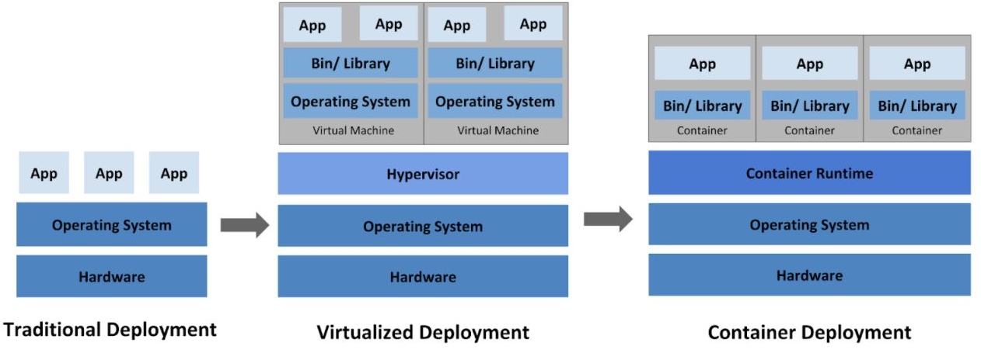
Traditional Deployment

Slide 4
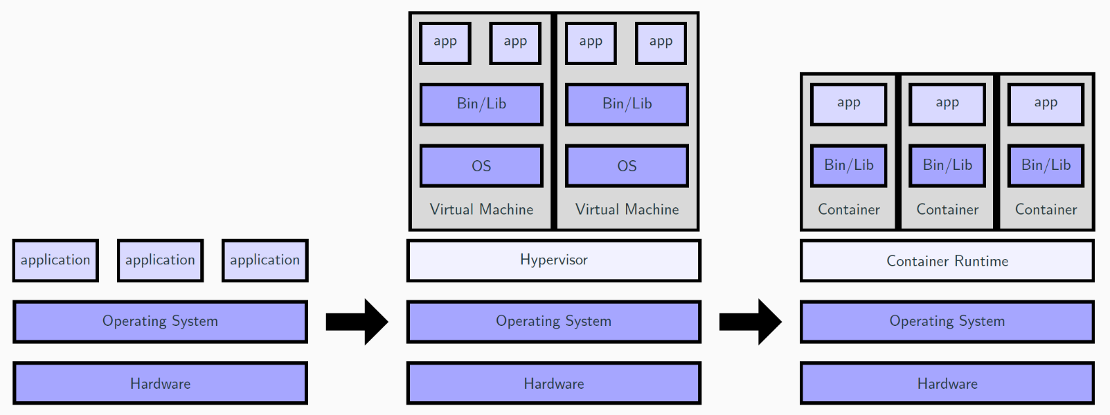
Traditional Deployment

Slide 5
Issues With Traditional Deployment
It was expensive for organizations to maintain many physical servers. It was very difficult to manage software dependencies
Unable to launch multiple applications on the same server with the same port
Each application have to launched in it own physical servers to avoid port conflict
It was very difficult to learn multiple operating systems using just one server or computer because we were unable to install multiple OS on the same servers or computer.

Slide 6
Cons of Traditional Deployment
It was expensive for organizations to maintain many physical servers. It was very difficult to manage software dependencies
Unable to launch multiple applications on the same server with the same port
Each application have to be launched in it own physical servers to avoid port conflict
It was very difficult to learn multiple operating systems using just one server or computer because we were unable to install multiple OS on the same servers or computer.

Slide 7
Pros Traditional Deployment
It avoid a single point of failure because each application is install in it own physical server
We do not have multiple applications install on the same server
It might enhance the performance and security of the application because each application has it own servers and physical hardware

Slide 8
Hypervisor

Slide 9
What is a Hypervisor?
It is a software install either on the physical hardware or on top an existing operating system.
A hypervisor is a program for creating and running virtual machines
It is used to manage virtual machines

Slide 10
What is a Virtual machine?
A Virtual Machine (VM) is a compute resource that uses software instead of a physical computer to run programs and deploy apps. The software here is called hypervisor.
Each virtual machine runs its own operating system and functions separately from the other VMs, even when they are all running on the same host

Slide 11
Why Hypervisor?
This was created to resolve some issue that we were having with the traditional deployment
It resolved some issue that we were having with the traditional deployment and brought some on the table such a single point of failure

Slide 12
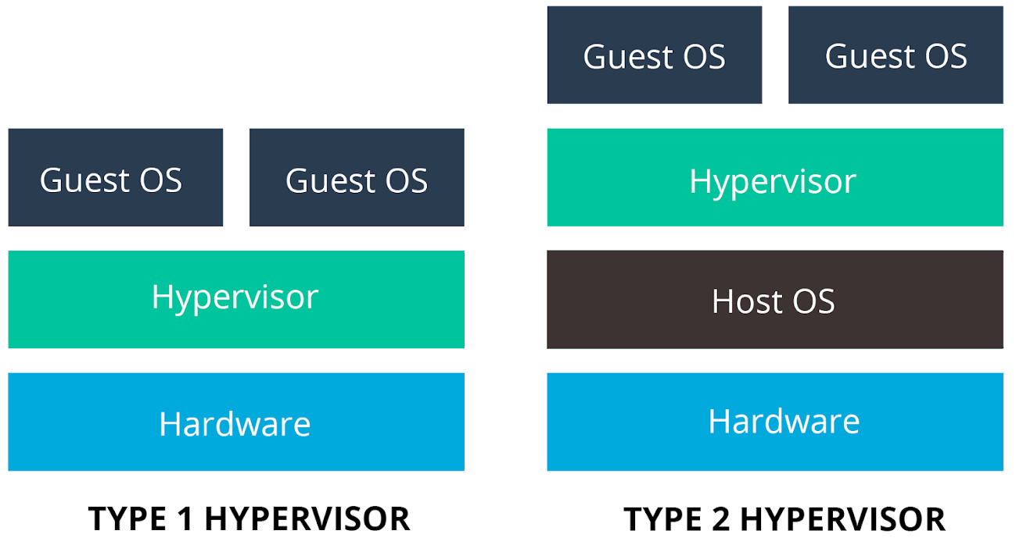
Types of Hypervisors
Type 1 hypervisor run on a physical hardware
Type 2 hypervisor run on top of an existing operation system

Slide 13
What is the Difference Between Type 1 and 2 Hypervisor?
Type 1 hypervisor run on a physical hardware
Type 2 hypervisor run on top of an existing operation system

Slide 14

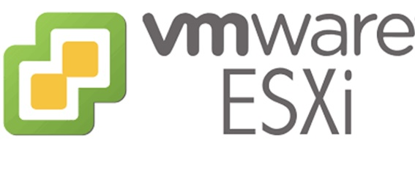
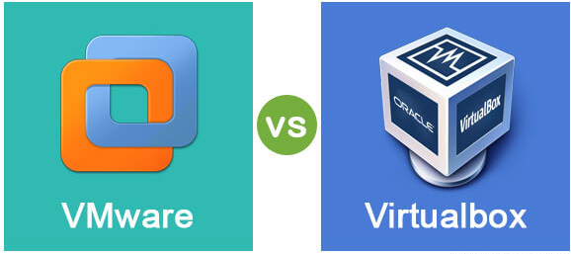
Hypervisor Tools
Vmware Workstation Pro
VirtualBox is a type 2 hypervisor and it is free
Vmware workstation is a type 2 hypervisor and it is license
Vmware ESXI is a type 1 hypervisor and it is license

Slide 15
Pos of Hypervisor
We can install multiple applications on the same server without having any port conflict. We can launch multiple operating system on the same server for learning purpose or to launch our application using a hypervisor
All VM share the same resources with the host OS.
It is less expensive than the traditional deployment

Slide 16
Cons of Hypervisor
The server or computer must be able to handle virtualization
We need a server with a lot of computer power or resources such as RAM and CPU
We have a single point of failure here because all our infrastructure in on the same server
Everything will be down if the main server is down

Slide 17
Virtualization

Slide 18
What is Virtualization?
Virtualization is the process of running a virtual instance of a computer system in a layer abstracted from the actual hardware. Most commonly, it refers to running multiple operating systems on a computer system simultaneously

Slide 19
Why Virtualization?
This was created to resolve some issue that we were having with the traditional deployment
It resolved some issue that we were having with the traditional deployment and brought some on the table such a single point of failure

Slide 20
Pros of Virtualization
We can install multiple applications on the same server without having any port conflict. We can launch multiple operating system on the same server for learning purpose or to launch our application using a hypervisor
All VM share the same resources with the host OS.
It is less expensive than the traditional deployment

Slide 21
Cons of Virtualization Compare to Traditional Deployment
The server or computer must be able to handle virtualization
We need a server with a lot of computer power or resources such as RAM and CPU
We have a single point of failure here because all our infrastructure in on the same server
Everything will be down if the main server is down

Slide 22
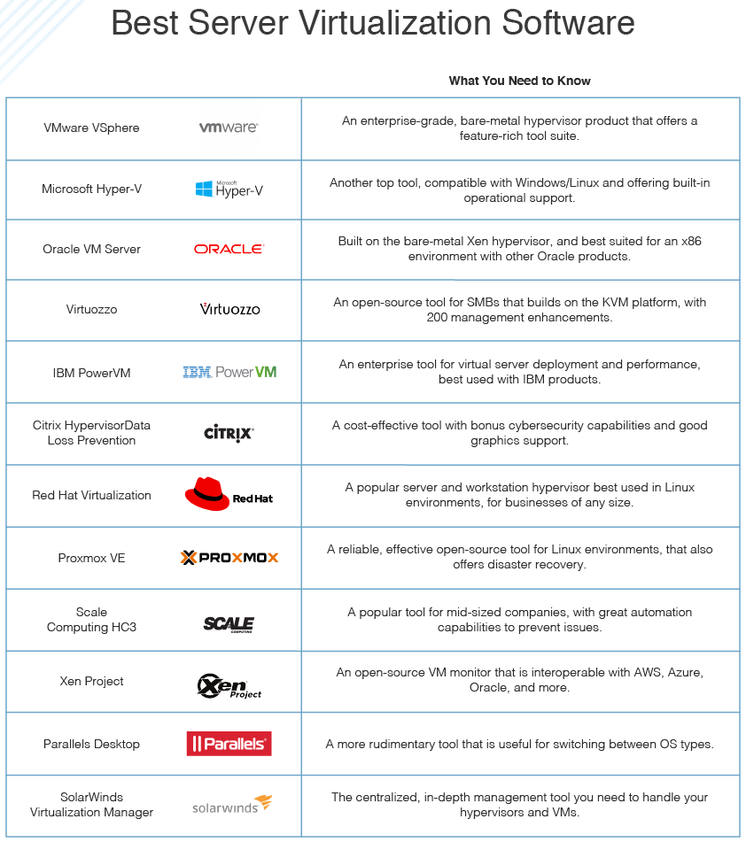
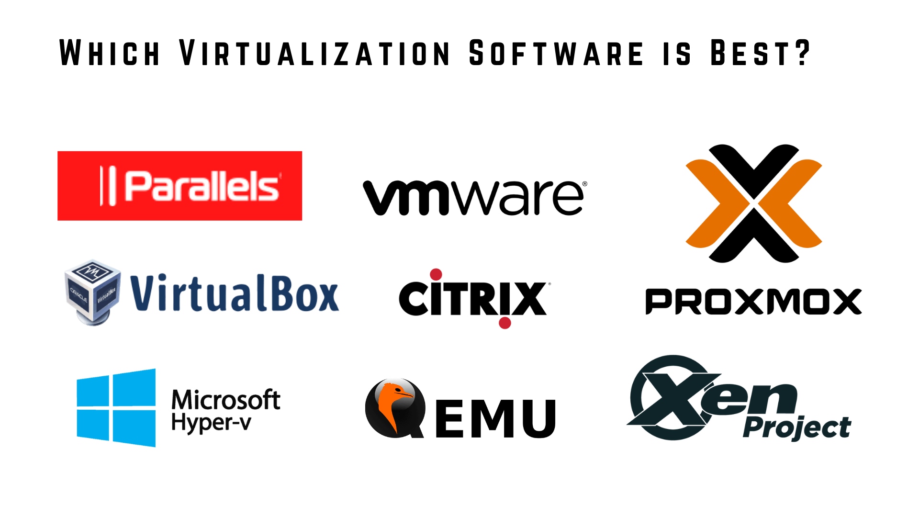
Virtualization Tools

Slide 23
Containerization

Slide 24
What is Containerization?
Containerization is a form of virtualization where applications run in isolated user spaces, called containers, while using the same shared operating system (OS). One of the benefits of containerization is that a container is essentially a fully packaged and portable computing environment.
Everything an application needs to run—its binaries, libraries, configuration files, and dependencies—is encapsulated and isolated in its container. The container itself is abstracted away from the host OS, with only limited access to underlying resources—much like a lightweight virtual machine (VM). As a result, the containerized application can be run on various types of infrastructure—on bare metal, within VMs, and in the cloud—without needing to refactor it for each environment.
With containerization technology, there’s less overhead during startup and no need to set up a separate guest OS for each application since they all share the same OS kernel. Because of this high efficiency, containerization is commonly used for packaging up the many individual microservices that make up modern apps.

Slide 25
Why Containerization?
This was created to resolve some issues that we were having with virtualization such package dependencies issue, computer resources, scalability (we can run multiple container in a single VM), VM size, issues with operation team and dev team, application running in it own VM, boot up process, port conflict issue, application not able to run in all environments , hypervisor licence issue, networking issue.

Slide 26
Pros of Containerization
Containers share the same Kernel with the host operating system.
Resolve package dependencies issues.
Resolve some issues between the development and the operation team
Application container technology offers high scalability

Slide 27
Cons of Containerization
Containers share the same Kernel with the host operating system.
Resolve package dependencies issues.
Resolve some issues between the development and the operation team
Application container technology offers high scalability

Slide 28
Pros and Cons

Slide 29
Pros and Cons of Traditional Deployment Compare to Virtualization

Slide 30
Pros and Cons of Traditional Deployment Compare to Virtualization

Slide 31
Pros and Cons of Containerization Compare to Virtualization

Slide 32
Pros and Cons of Containerization Compare to Virtualization

Slide 33
Pros and Cons Docker Swarm Compare to Kubernetes

Slide 34
What is The Difference Between …..

Slide 35
What is the Difference Between Containerization and Virtualization?

Slide 36
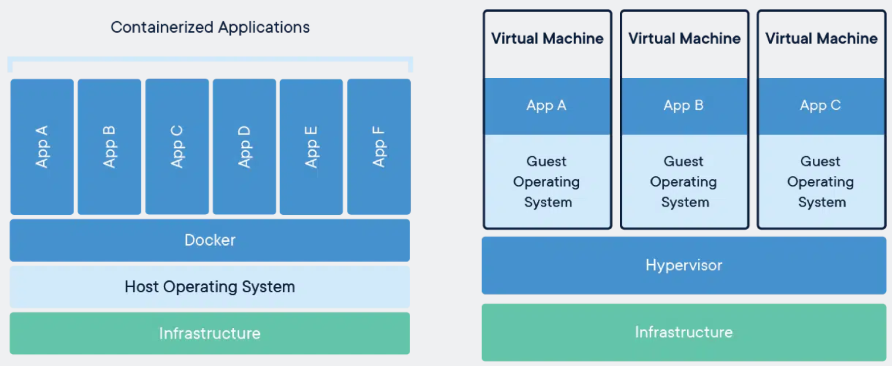
What is the Difference Between Containerization and Virtualization?

Slide 37
What is the Difference Between Containerization and Virtualization?
VM requires an Hypervisor which can be either installed on an operating system or directly on the hardware while a container can be deployed after installing docker.
VM requires a separating OS to be installed to deploy your application while Docker containers share the host operating system, and that is why they are lightweight
Since Docker shares OS with host, the boot up time of docker container is very less while it is comparatively higher for VMs
Since VM does not share the host OS, it is comparatively more secure than Docker containers. An attacker may exploit all the containers if it gets access to the host or any single container.
Since containers don’t have OS, they use comparatively very less resources to execute the application and you can utilize the underlying resources more effectively

Slide 38
What is the Difference Between Type 1 and Type 2 Hypervisor?

Slide 39
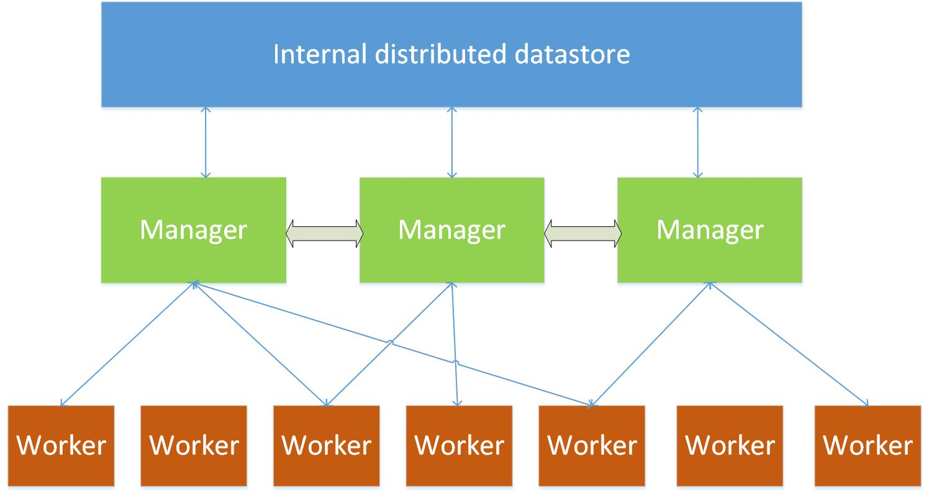
What is the Difference Between Docker Swarm and Kubernetes?
If the host down, the entire application of infrastructure is down will not be down here because copy of the application will be running on another host

Slide 40
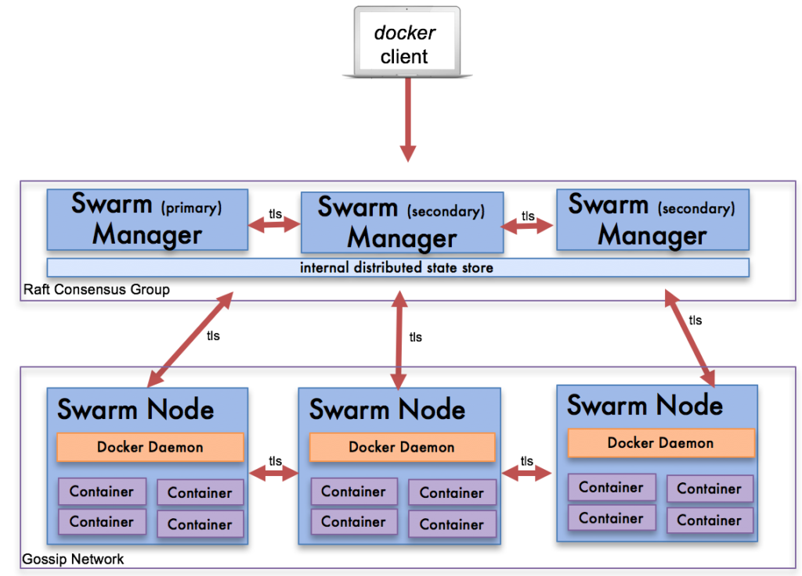
What is the Difference Between Docker Swarm and Kubernetes?
If the host down, the entire application of infrastructure is down will not be down here compare to a single host deployment because copy of the application will be running on another host
How do we scale node up automatically
How do we achieve horizontal scaling?
How do we achieve vertical scaling?
How do we handle high availability?
How do we deploy application with zero downtime?
How we handle networking efficiently?

Slide 41
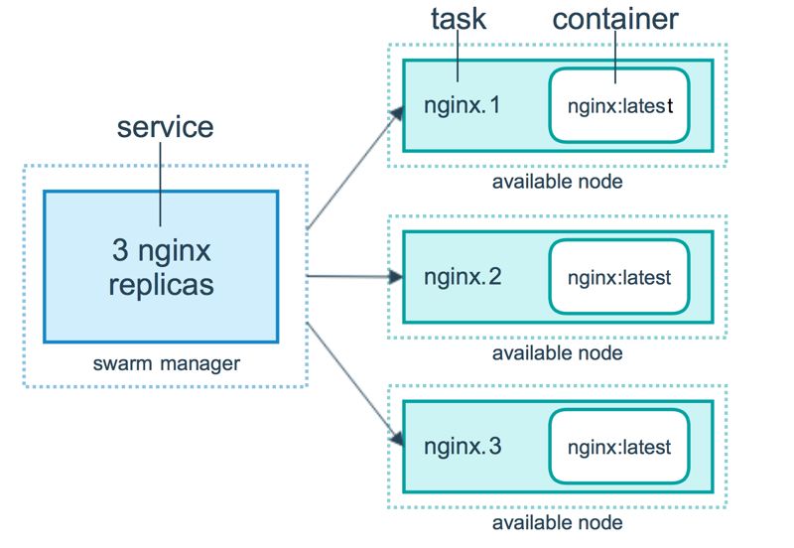
What is the Difference Between Docker Swarm and Kubernetes?
High availability in docker swarm

Slide 42
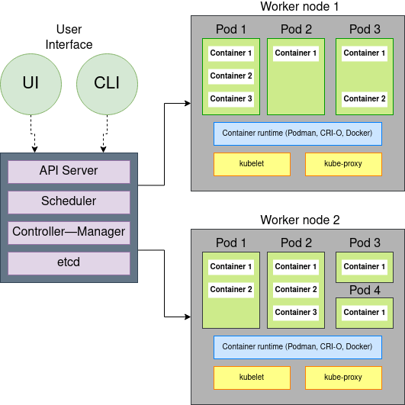
What is the Difference Between Docker Swarm and Kubernetes?
How do we scale node up automatically
How do we achieve horizontal scaling?
How do we achieve vertical scaling?
How do we handle high availability?
How do we deploy application with zero downtime?
How we handle networking efficiently?

Slide 43
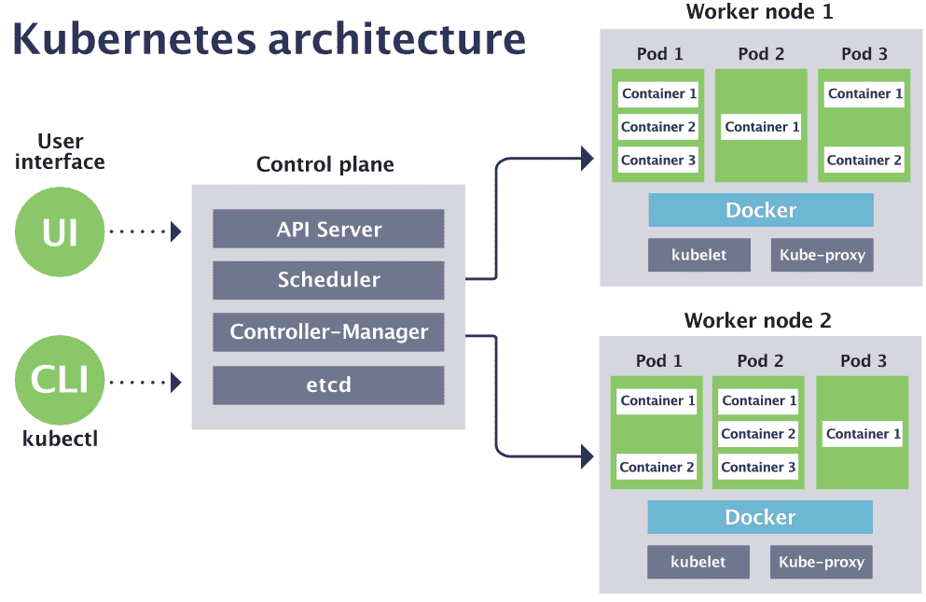
What is the Difference Between Docker Swarm and Kubernetes?
How do we scale node up automatically
How do we achieve horizontal scaling?
How do we achieve vertical scaling?
How do we handle high availability?
How do we deploy application with zero downtime?
How we handle networking efficiently?

Slide 44
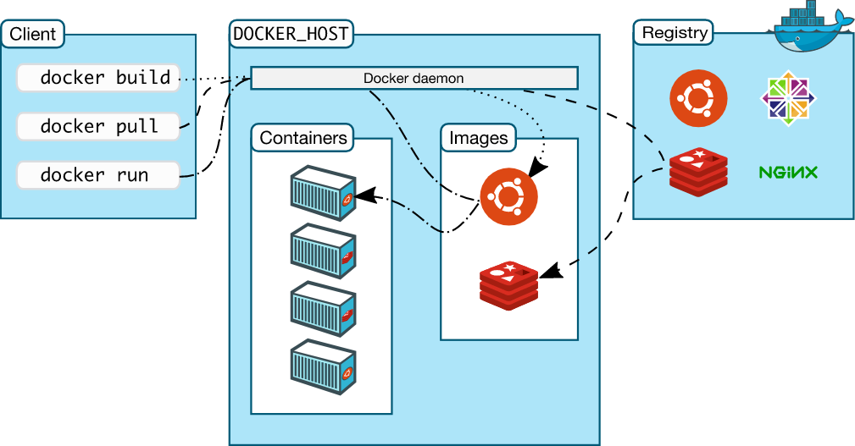
What is the Difference Between Docker Swarm and Kubernetes?
Application running on a docker single host.
If the host down, the entire application of infrastructure is down

Slide 45
Microservices

Slide 46
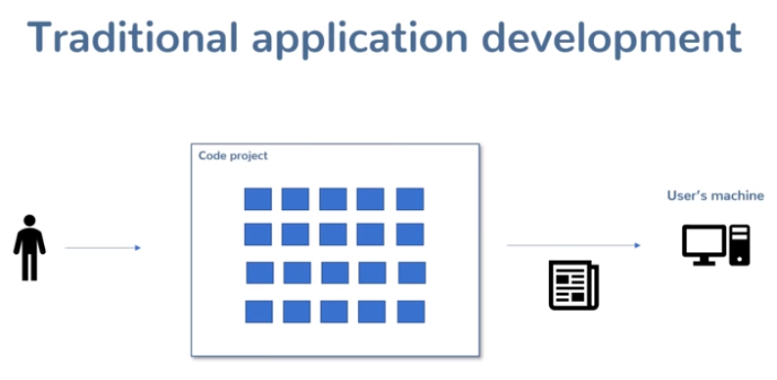
What is Microservices?
Monolithic architecture: It is an architectural style in which all the functionalities or required components would be inside one block.
All your eggs are in one basket with Monolithic architecture.

Slide 47
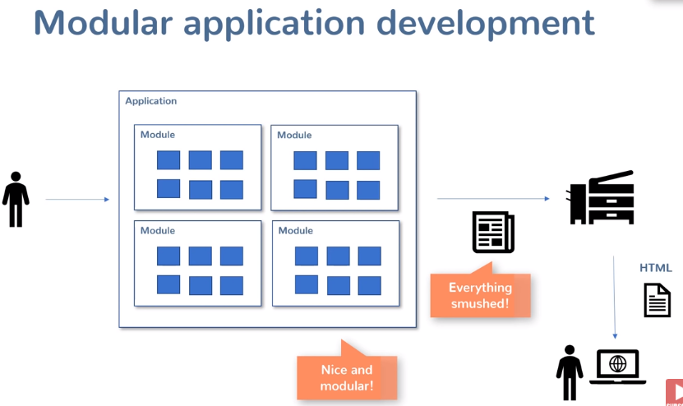
What is Microservices?
Monolithic architecture: It is an architectural style in which all the functionalities or required components would be inside one block.
All your eggs are in one basket with Monolithic architecture.

Slide 48
What is Microservices?
Microservices are a way of breaking your application or service down into stand alone independent application that can be run into several hardwares or serves instances. They all talk together over API and work together to provide the functionality of your application or product. We have multiple stand alone applications that work together to form our application.
Advantages of microservices?
Deployment flexibility: different team can build and deploy application in dependenly. The release does not matter in which language you use.
Technology flexibility: You do not have to use a common language. We can use different languages to build the application because each microservice in running as a standalone application
Can be scaled separately: we can scale any microservice as needed during traffic spy, just scale any microservices that are the most used. (black friday)
What are microservices really all about?

Slide 49
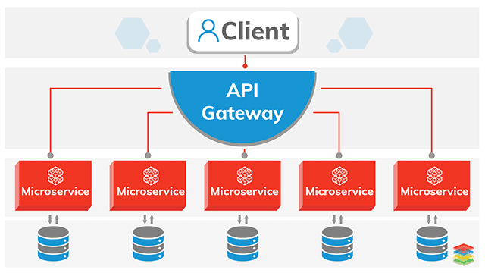
Microservices
API = Application Programming Interface

Slide 50
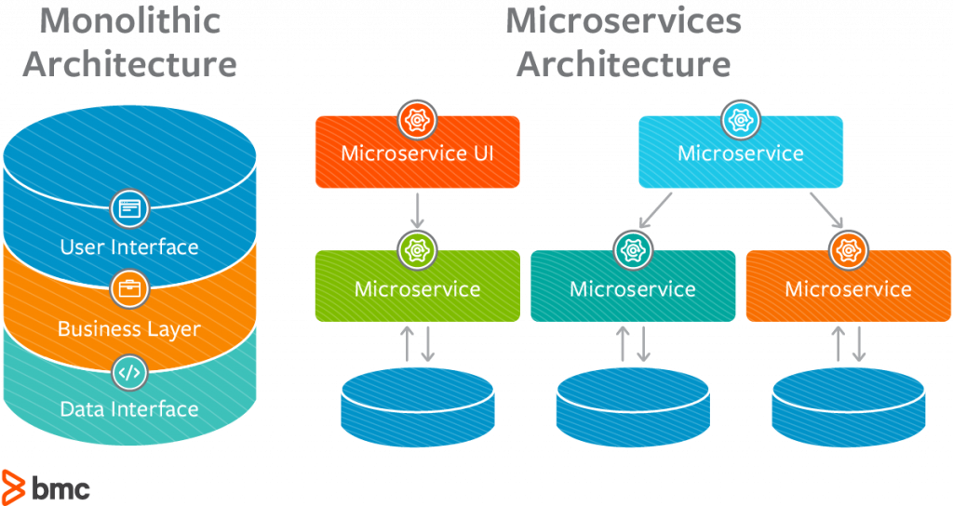
Microservices
API = Application Programming Interface

Slide 51
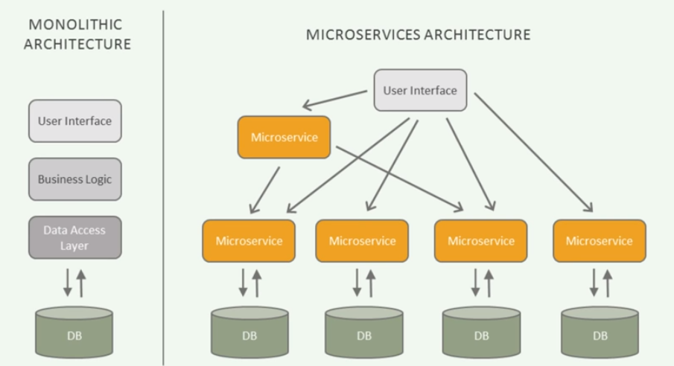
Microservices
API = Application Programming Interface

Slide 52
Docker Registry

Slide 53
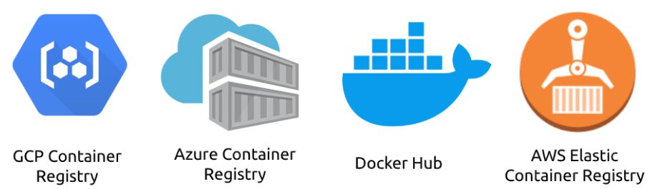
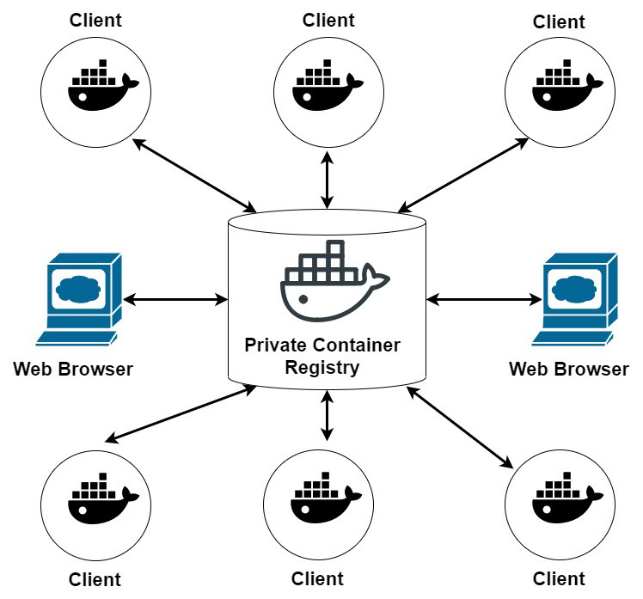
Docker Hub Registry
Docker Hub is a hosted repository service provided by Docker for finding and sharing container images with your team.
Docker hub is free

Slide 54
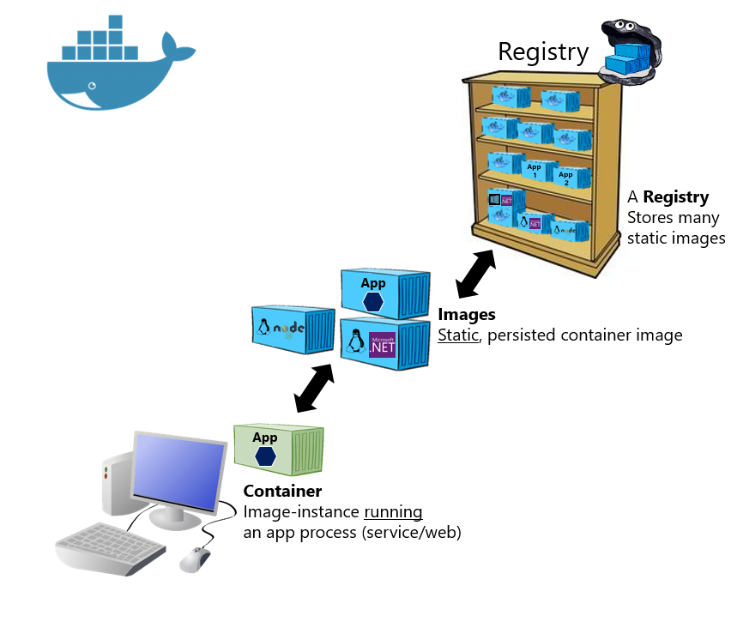
Docker Hub Registry
Like Docker Hub, Docker Trusted Registry (DTR) is a solution that allows organizations to store and manage Docker containers. However, DTR can be on the server, allowing complete control over how and where the registry is available and accessed from within your environment.
This is not free because will have to launch a servers and install the (DTR) and pay for it

Slide 55
AWS ECR Registry
Amazon Elastic Container Registry (ECR) is a fully-managed Docker container registry that makes it easy for developers to store, manage, and deploy Docker container images. Amazon ECR is integrated with Amazon Elastic Container Service (ECS), simplifying your development to production workflow.
Amazon ECR eliminates the need to operate your own container repositories or worry about scaling the underlying infrastructure. Amazon ECR hosts your images in a highly available and scalable architecture, allowing you to reliably deploy containers for your applications. Integration with Amazon Identity and Access Management (IAM) provides resource-level control of each repository. With Amazon ECR, there are no upfront fees or commitments. You pay only for the amount of data you store in your repositories and data transferred to the Internet.
ECR can automatically scan your image to make sure there is no vulnerability when enable. We do not really a third party tool to scan the image

Slide 56

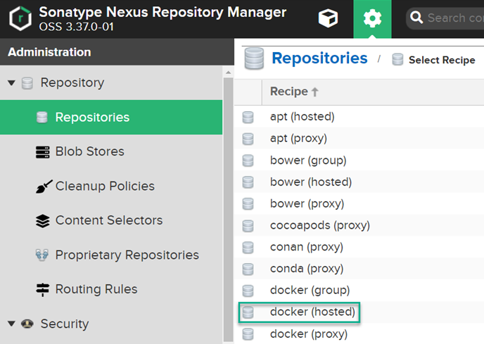
Nexus Container Registry
Nexus as a Container Registry powers enterprises Docker for container storage management and K8s deployments

Slide 57
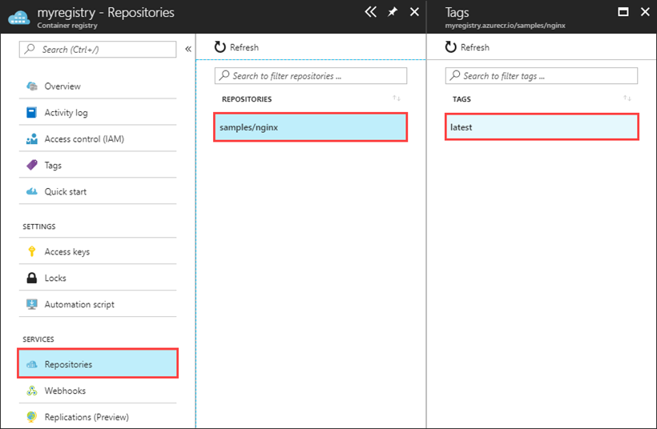
Azure Container Registry
Azure Container Registry allows you to build, store, and manage container images and artifacts in a private registry for all types of container deployments

Slide 58
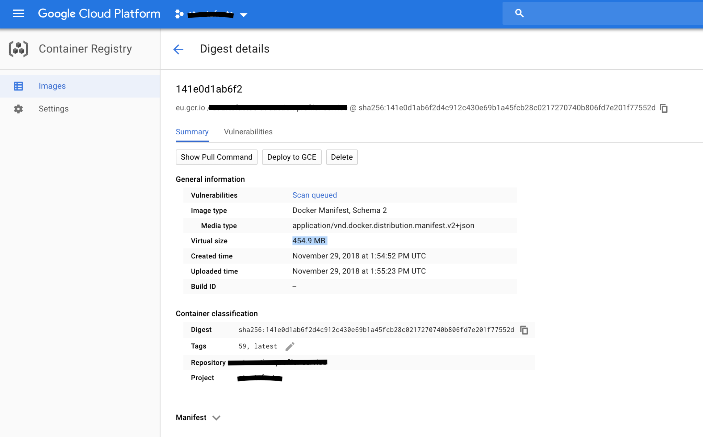
GCP Container Registry
Google Cloud Container Registry is a place to manage Docker images, perform vulnerability analysis, and decide who can access what with fine-grained access control

Slide 60
Terminologies

Slide 61

What is Docker?
Docker is a software platform that allows you to build, test, and deploy applications quickly. Docker packages software into standardized units called containers that have everything the software needs to run including libraries, system tools, code, and runtime. Using Docker, you can quickly deploy and scale applications into any environment and know your code will run.
Docker is a platform which packages an application and all its dependencies together in the form of containers. This containerization aspect ensures that the application works in any environment.

Slide 62
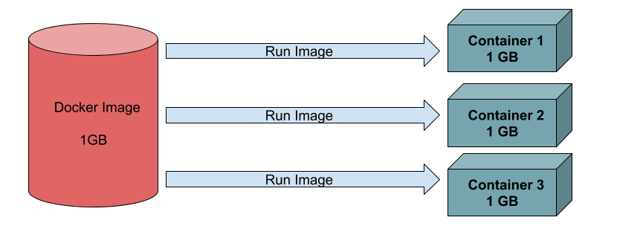
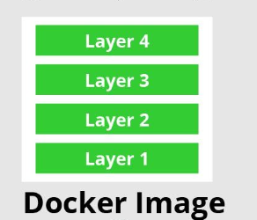
What is Docker Image?
Docker Image is an executable package of software that includes everything needed to run an application. This image informs how a container should instantiate, determining which software components will run and how. It contains application code with all the dependencies required to run the application.
A Docker image is a read-only template that contains a set of instructions for creating a container that can run on the Docker platform
A Docker is an executable package that contains a set of instructions for creating a container that can run on the Docker platform. It provides a convenient way to package up applications and preconfigured server environments, which you can use for your own private use or share publicly with other Docker users

Slide 63
What is a container?
Docker Image: It is an running instance of docker images
When we run an image, It create a container

Slide 64
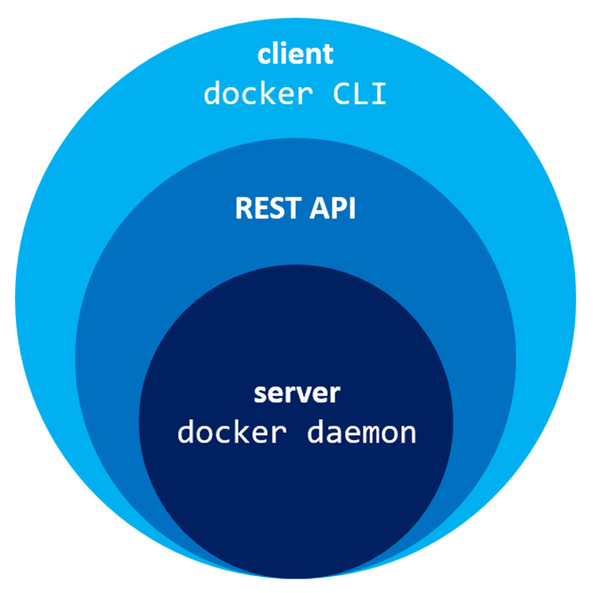
What is Docker Host?
A Docker host is a physical or virtual server on which the core component of Docker runs, the Docker engine

Slide 65
What is Docker Daemon?
The Docker daemon ( dockerd ) listens for Docker API requests and manages Docker objects such as images, containers, networks, and volumes.
The Docker daemon is a service that runs on your host operating system. It currently only runs on Linux because it depends on a number of Linux kernel features, but there are a few ways to run Docker on MacOS and Windows too.

Slide 66
What is Docker Client?
The Docker Client is where we’re running various Docker commands. The client could be installed on your laptop running Windows, MacOS or a server running Linux, it doesn’t matter

Slide 67
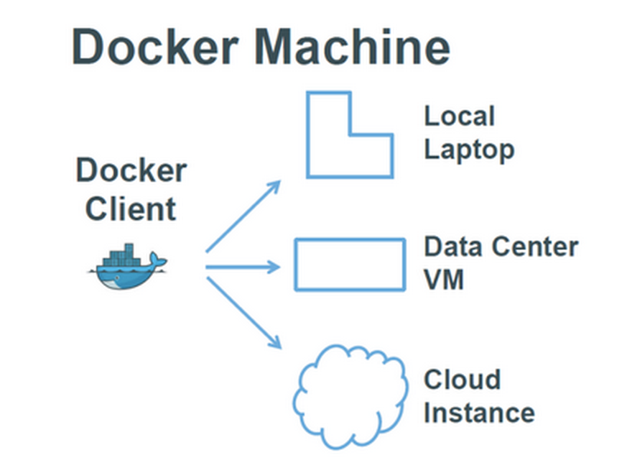
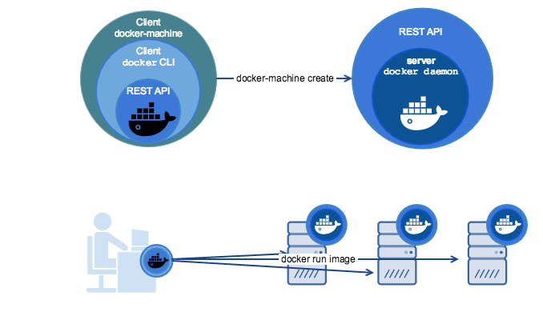
What is Docker Machine?
Docker Machine is a tool that lets you install Docker Engine on virtual hosts, and manage the hosts with docker-machine commands. You can use Machine to create Docker hosts on your local Mac or Windows box
It is use to create docker host

Slide 68
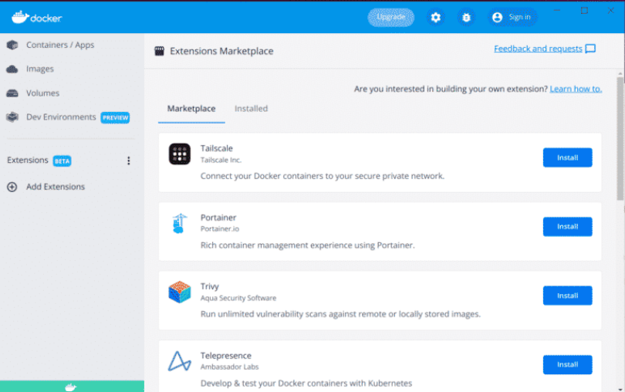
What is Docker Desktop?
Docker Desktop is a one-click-install application for your Mac, Linux, or Windows environment that enables you to build and share containerized applications and microservices

Slide 69
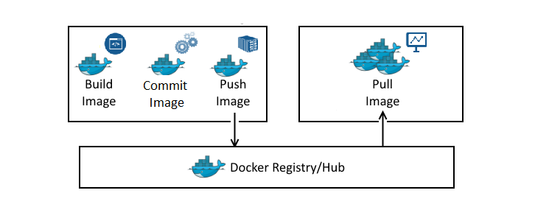
What is Docker Registry?
A Docker registry is a storage and distribution system for storing Docker images. The same image might have multiple different versions, identified by their tags. A Docker registry is organized into Docker repositories , where a repository holds all the versions of a specific image

Slide 70
What is Docker Swarm?
A Docker Swarm is a group of either physical or virtual machines that are running the Docker application and that have been configured to join together in a cluster. The activities of the cluster are controlled by a swarm manager, and machines that have joined the cluster are referred to as nodes

Slide 71
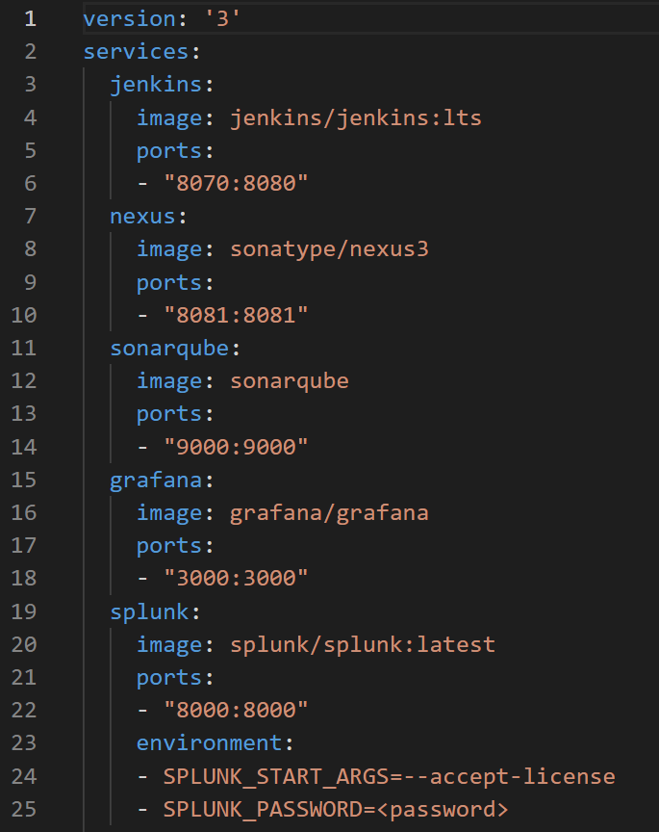
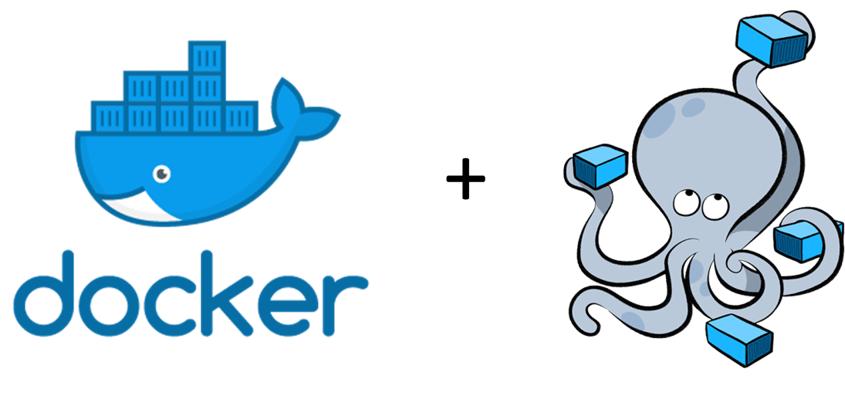

What is Docker Compose?
Docker Compose is a tool for running multi-container applications on Docker defined using the Compose file format. A Compose file is used to define how one or more containers that make up your application are configured.
We can run a Compose file in docker swarm and in docker single host

Slide 72
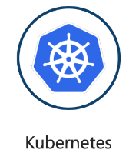



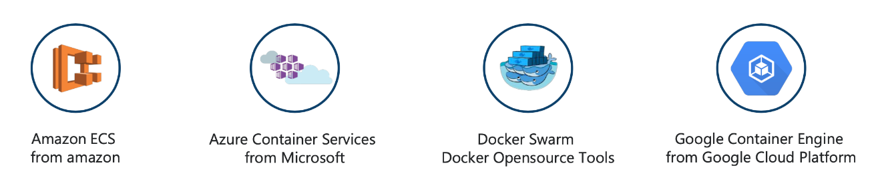
What is a Container Orchestration?
Container orchestration is a process that automates the deployment, management, scaling, networking, and availability of container-based applications. Also, it helps in monitoring the cluster and allow containers to communicate with one another.

Slide 73
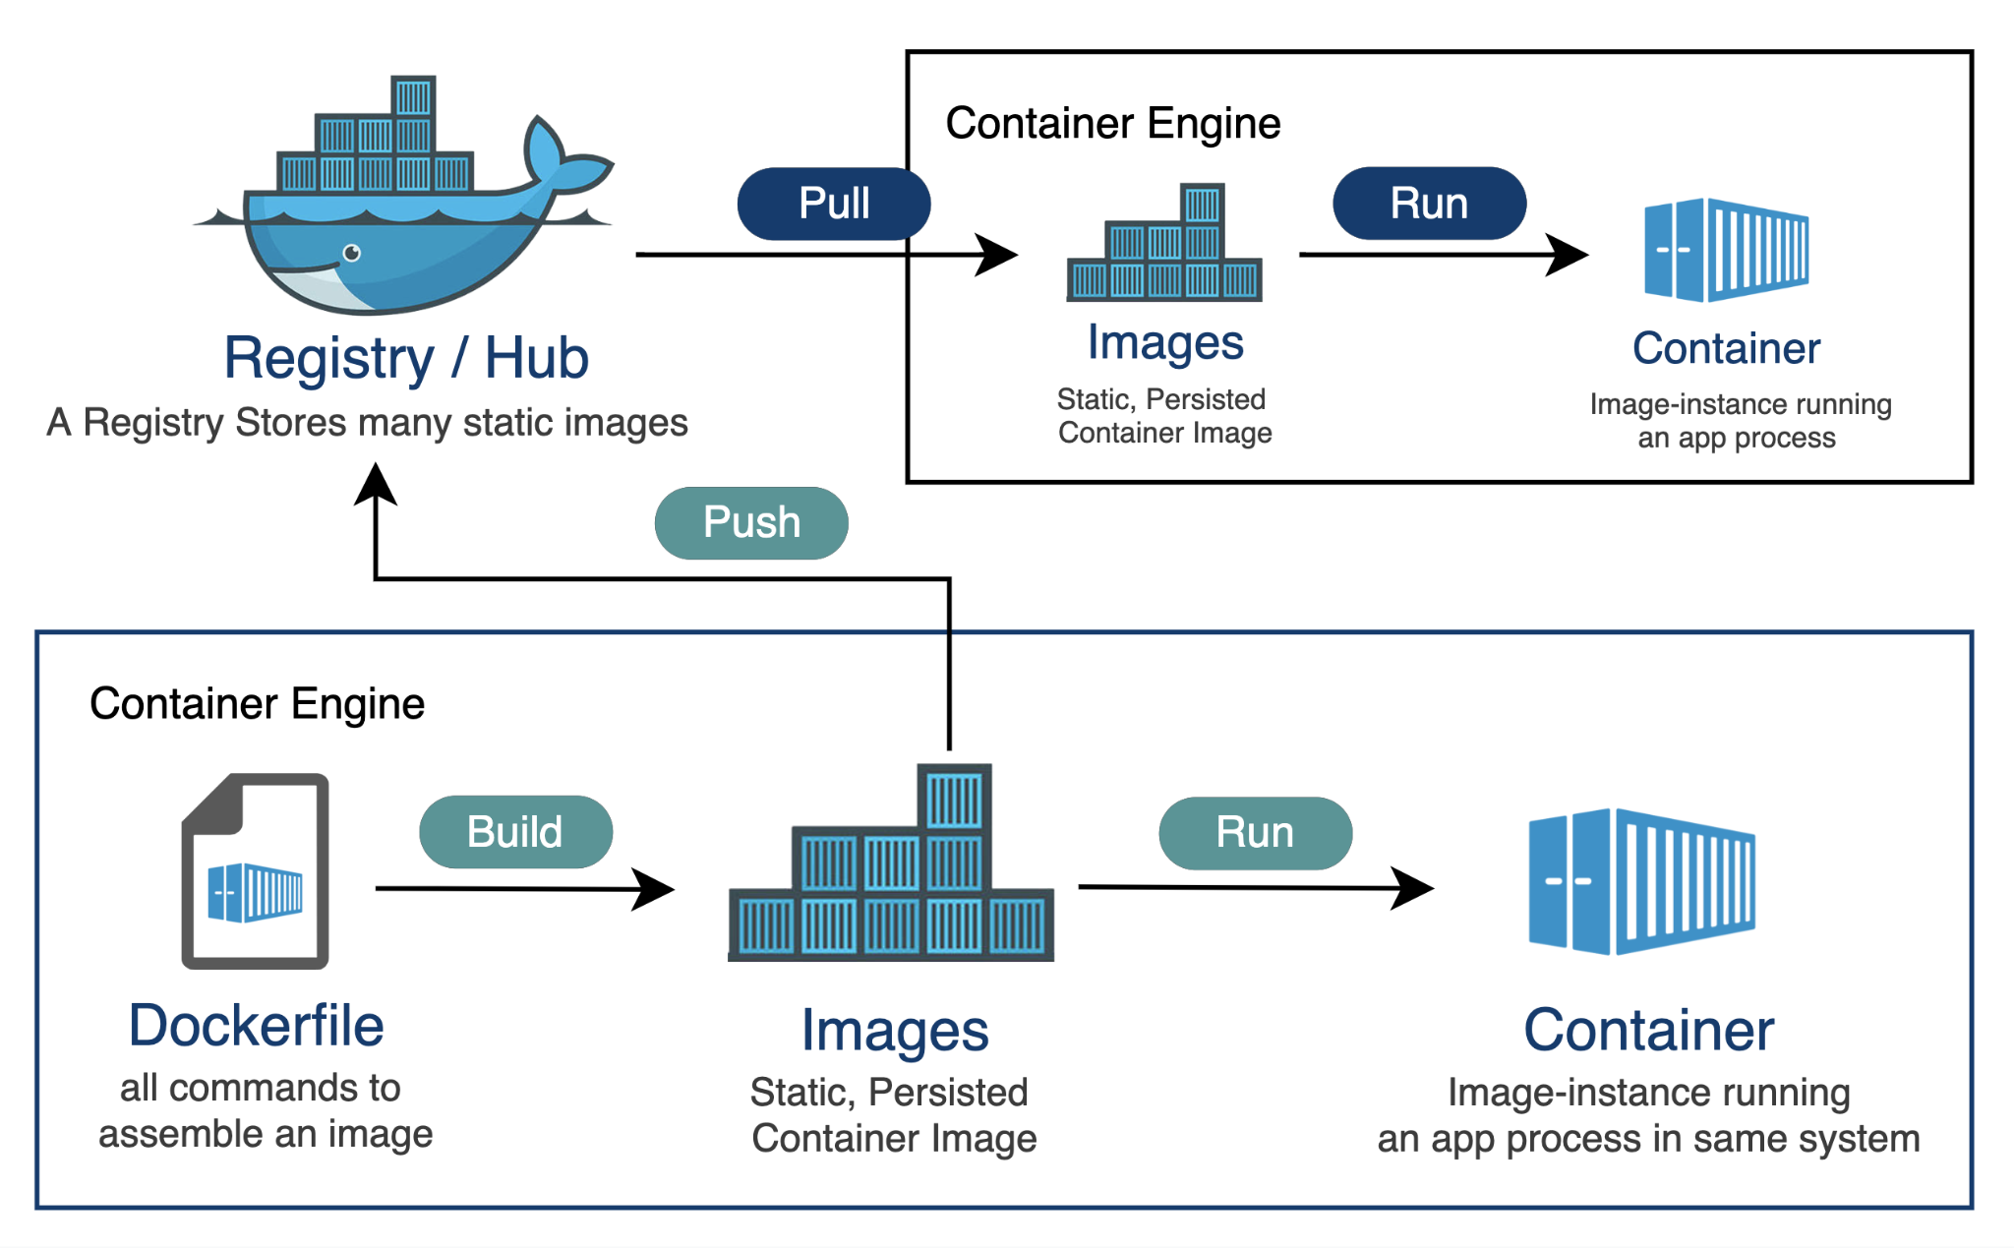
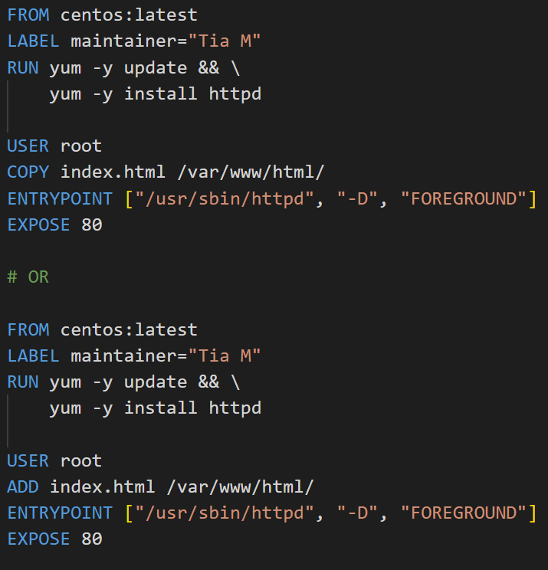
What is a Dockerfile?
A Dockerfile is a text file that carry out all the instructions to build a custom image

Slide 74
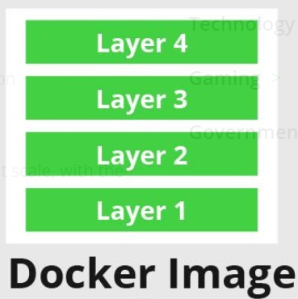
What is a Base Image?
The base image is the starting point for most container-based development workflows. Most base images are basic or minimal Linux distributions: Debian, Ubuntu, Redhat, Centos, or Alpine. Developers usually consume these images directly from Docker Hub, or other sources
In simple terms, a base image is an empty first layer, which allows you to build your Docker images from scratch

Slide 75
Docker Hub Work Through

Slide 76
Docker Hub Registry Work Through
Topics
Learn about public repositories
Learn about private repositories
Learn repositories naming convention
Create a repository
Delete a repository
Explore repositories
Learn base images form official repositories
<username>/repository name:tag
leonardtia/devops-pro-repos:stutendent_registration

Slide 77
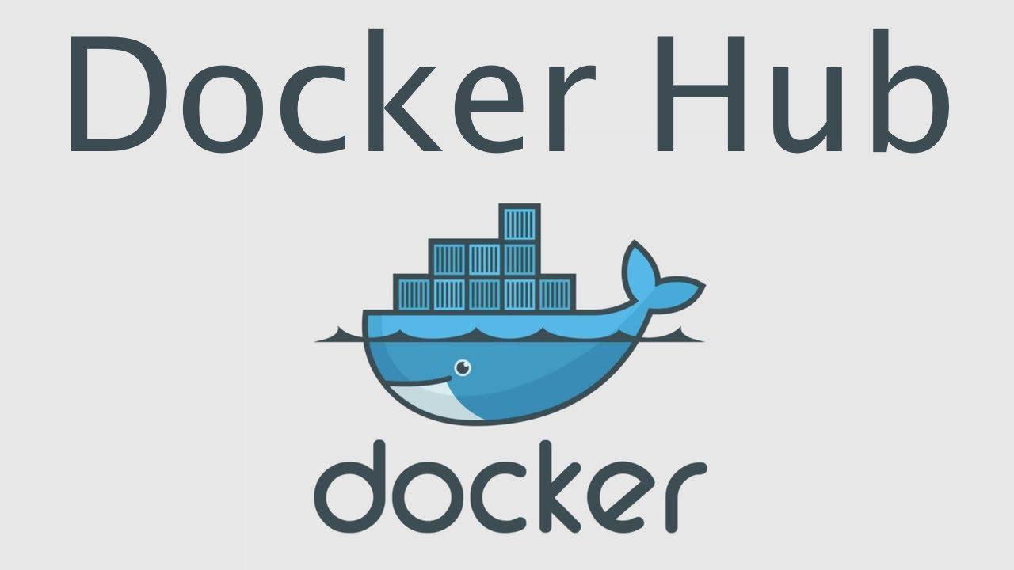

What is docker hub ?
Docker Hub is a service provided by Docker for finding and sharing container images with your team.

Slide 78
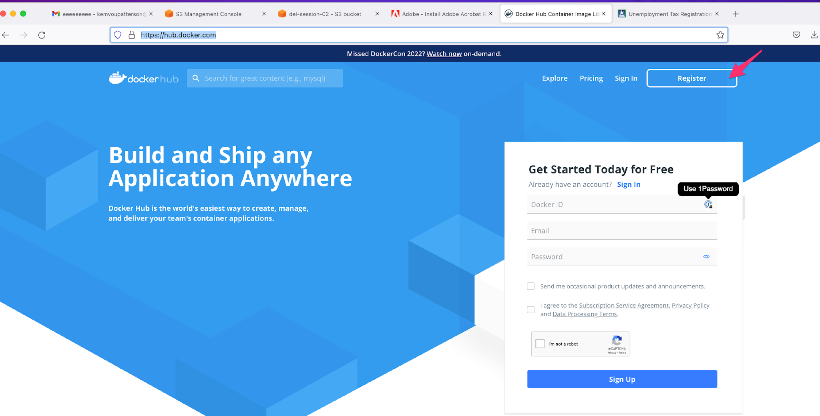
How to login register?
1- open https://hub.docker.com/
2- click on login and follow instructions, to open an account is free DevOps Easy Learning already have one for you

Slide 79

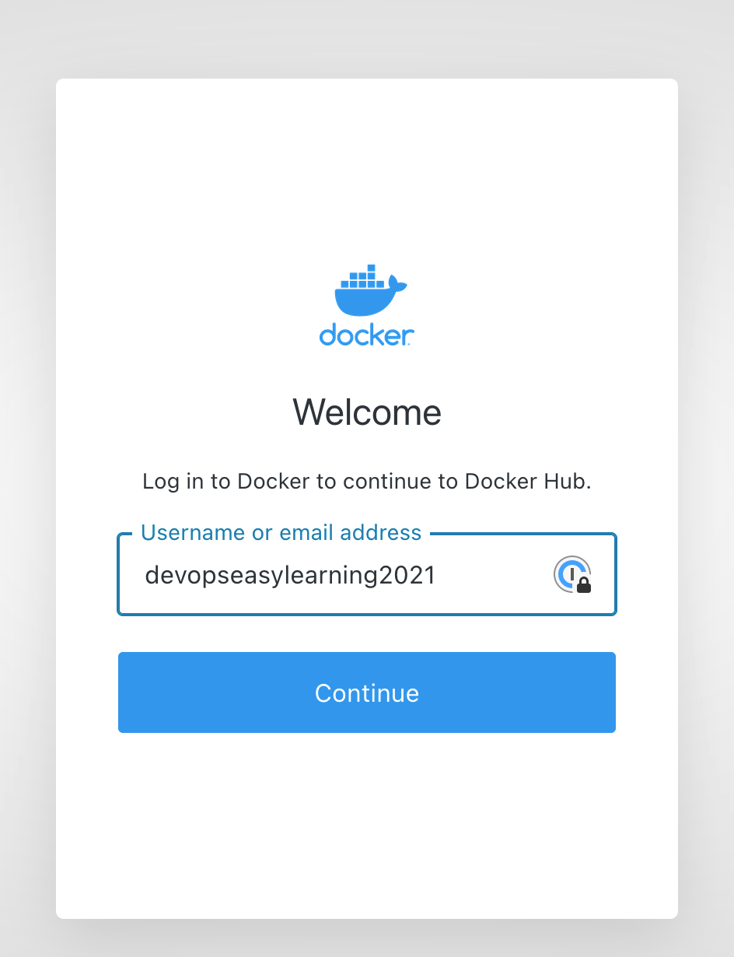
How to log in DevOps Easy Learning docker hub account?
1- open https://hub.docker.com/
2- click on register and follow instructions
Username: devopseasylearning2021
Password: DevOps2021@

Slide 80
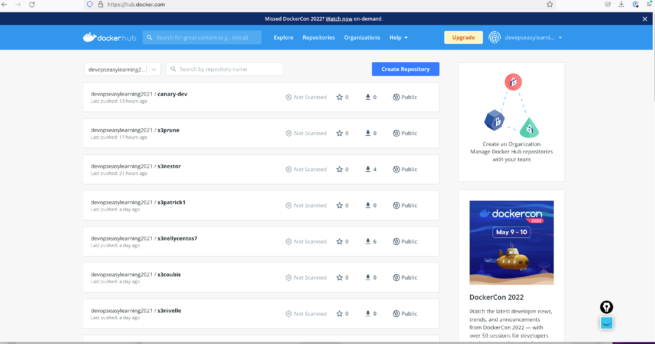
DevOps Easy Learning docker hub account main page

Slide 81

What is a docker repository ?
A Docker repository is where you can store 1 or more versions of a specific Docker image.
An image can have 1 or more versions (tags).

Slide 82
What is a docker registry ?
A Docker registry is a storage and distribution system for named Docker images. The same image might have multiple different versions, identified by their tags.
A Docker registry is organized into Docker repositories , where a repository holds all the versions of a specific image. The registry allows Docker users to pull images locally, as well as push new images to the registry (given adequate access permissions when applicable).
By default, the Docker engine interacts with Docker Hub , Docker public registry instance. However, it is possible to run on-premise the open-source Docker registry/distribution, as well as a commercially supported version called Docker Trusted Registry . There are other public registries available online.

Slide 83
Difference between a Registry, Repository and Image
A Docker repository is where you can store 1 or more versions of a specific Docker image. An image can have 1 or more versions (tags).
A Docker image can be compared to a git repo. A git repo can be hosted inside of a GitHub repository, but it could also be hosted on Gitlab, BitBucket or your own git repo hosting service. It could also sit on your development box and not be hosted anywhere.
The same goes for a Docker image. You can choose to not push it anywhere, but you could also push it to the Docker Hub which is both a public and private service for hosting Docker repositories. There are other third party repository hosting services too.
The thing to remember here is a Docker repository is a place for you to publish and access your Docker images. Just like GitHub is a place for you to publish and access your git repos.
It’s also worth pointing out that the Docker Hub and other third party repository hosting services are called “registries”. A registry stores a collection of repositories.
You could say a registry has many repositories and a repository has many different versions of the same image which are individually versioned with tags.

Slide 84
Difference between a Registry, Repository and Image in simple words
A registry is just like a warehouse that contains repository
A repository is a warehouse that contains images
Image are the main elements that docker store
Tags are different image version
Example;
Imagine you rent a very big and huge warehouse to store cars
In that warehouse you store 15 containers with different sizes (A, B, C D,……..etc)
Inside those containers you have multiple cars (Toyota, Nissan, Honda……… etc)
Here the warehouse is your registry
Containers are your repository as you can see containers(repositories) were placed and kept inside the warehouse(registry) and inside each containers (repositories) we have multiple type of cars(tags)

Slide 85
What is docker official image
The Docker Official Images are images certified by docker that can be used by anyone

Slide 86
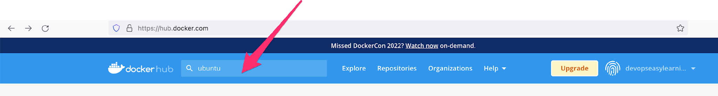
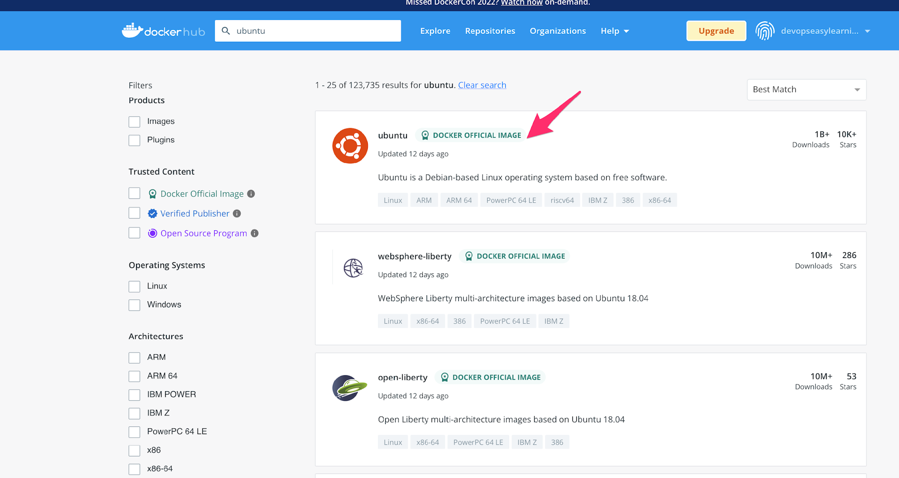
How to access official image
1- got to dockerhub ( you don’t need to login it is optional
2- on the search bar enter the image you would like to explore and press enter on your keyboard
3- click on the official image you would like to explore
Notice that all official image are stamped in green it means that if they are not stamped in green they are not official
Click anywhere here to explore the image

Slide 87
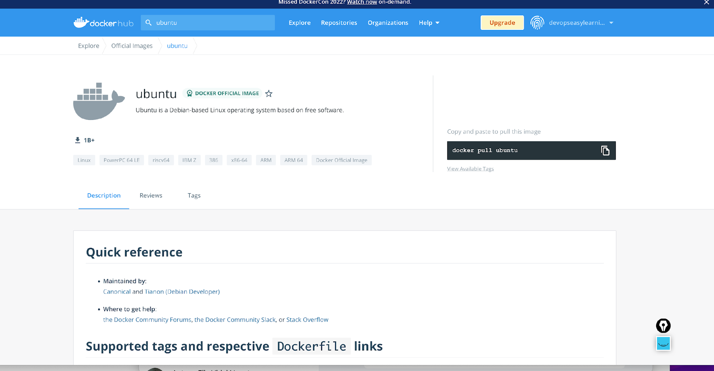
How to access official image
You can scroll down to read more about the image
A deep explanation will be provided in class

Slide 88
How to access official image
Copy the command to pull this image
Click here to see all tag

Slide 89
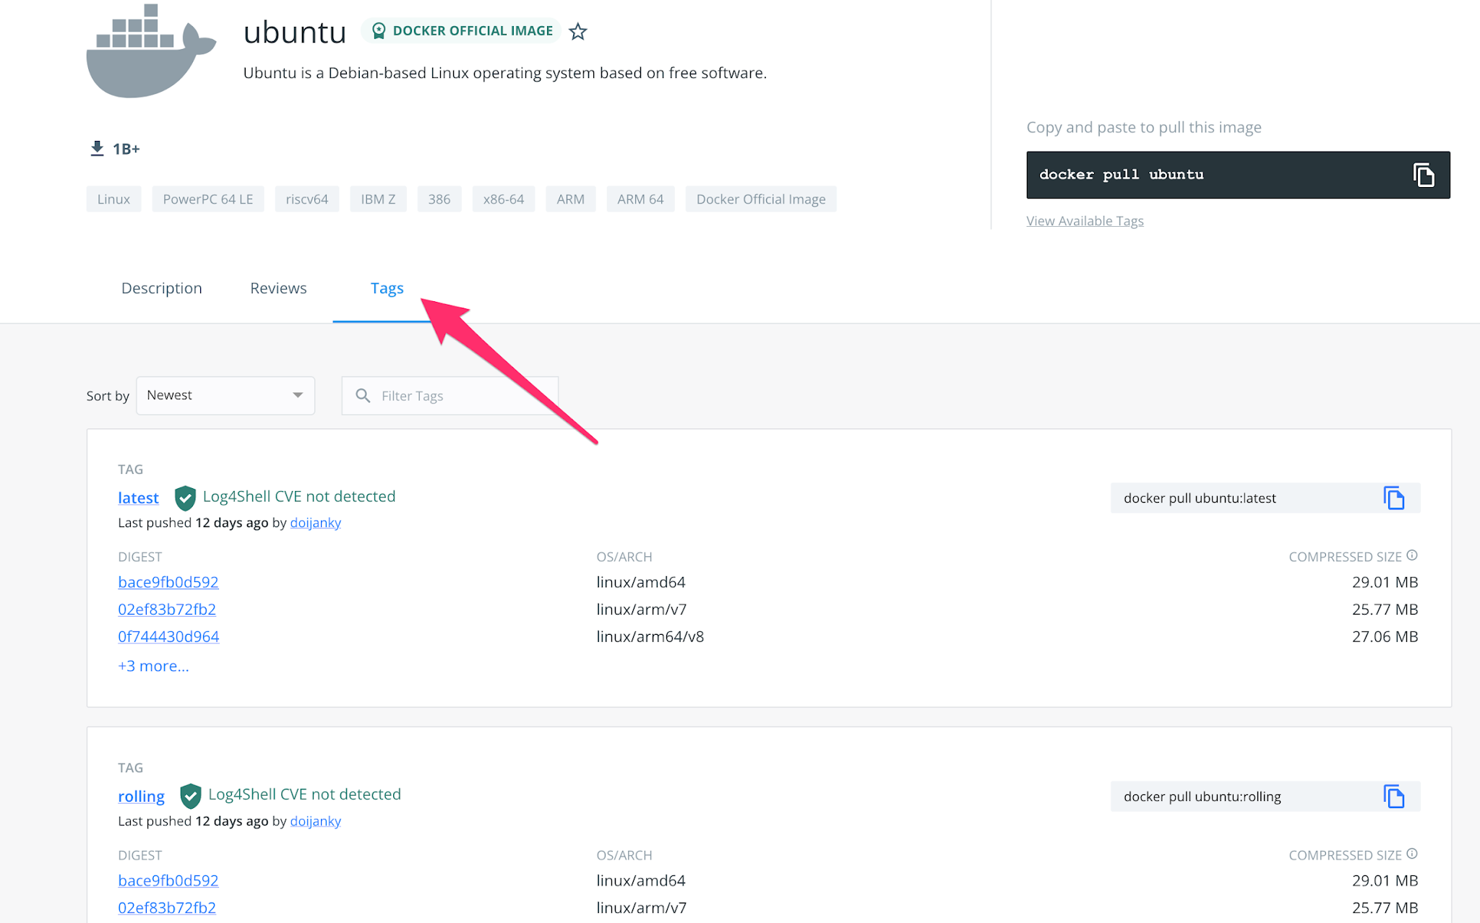
How to access official image
Click on any tag to explore it
We will explain this more in class
Scroll down to see more tags
Click here to see all tag

Slide 90
How to pull official image?
$ docker pull [ official image name ]: [tag]
$ docker pull ubuntu:20.04
$ docker pull centos:centos7
How to pull non official image
$ docker pull username or docker hub account name ]/[repository name]: [tag]
$ docker push devopseasylearning2021/canary-dev:2268f
$ docker pull kemvoueric/redis-client:v1.1.0
$ docker pull nestio/s3cmd-sync:2.1-2

Slide 91
Dockerhub account structure (non official images)
2
4
1- repository name or docker hub username
2- the slash tells docker that whatever before the slash is the repository name
3- the repository where docker should go pull the image
4- the : tells docker that the string (word) before the : is the repository name
5- is the image version to fetch or pull so a repository can have multiple image version
docker pull devopseasylearning2021/canary-dev:tagname
1
3
5

Slide 92
Non official image vs official image
docker pull username or docker hub account name ]/[repository name]: [tag]
$ docker push devopseasylearning2021/canary-dev:2268f
$ docker pull kemvoueric/redis-client:v1.1.0
$ docker pull nestio/s3cmd-sync:2.1-2
Official image DON’T have username on their structure compared to non official image that have username
Damn very simple and obvious again to notice
$ docker pull [official image name]: [tag]
$ docker pull ubuntu:20.04
$ docker pull centos:centos7

Slide 93
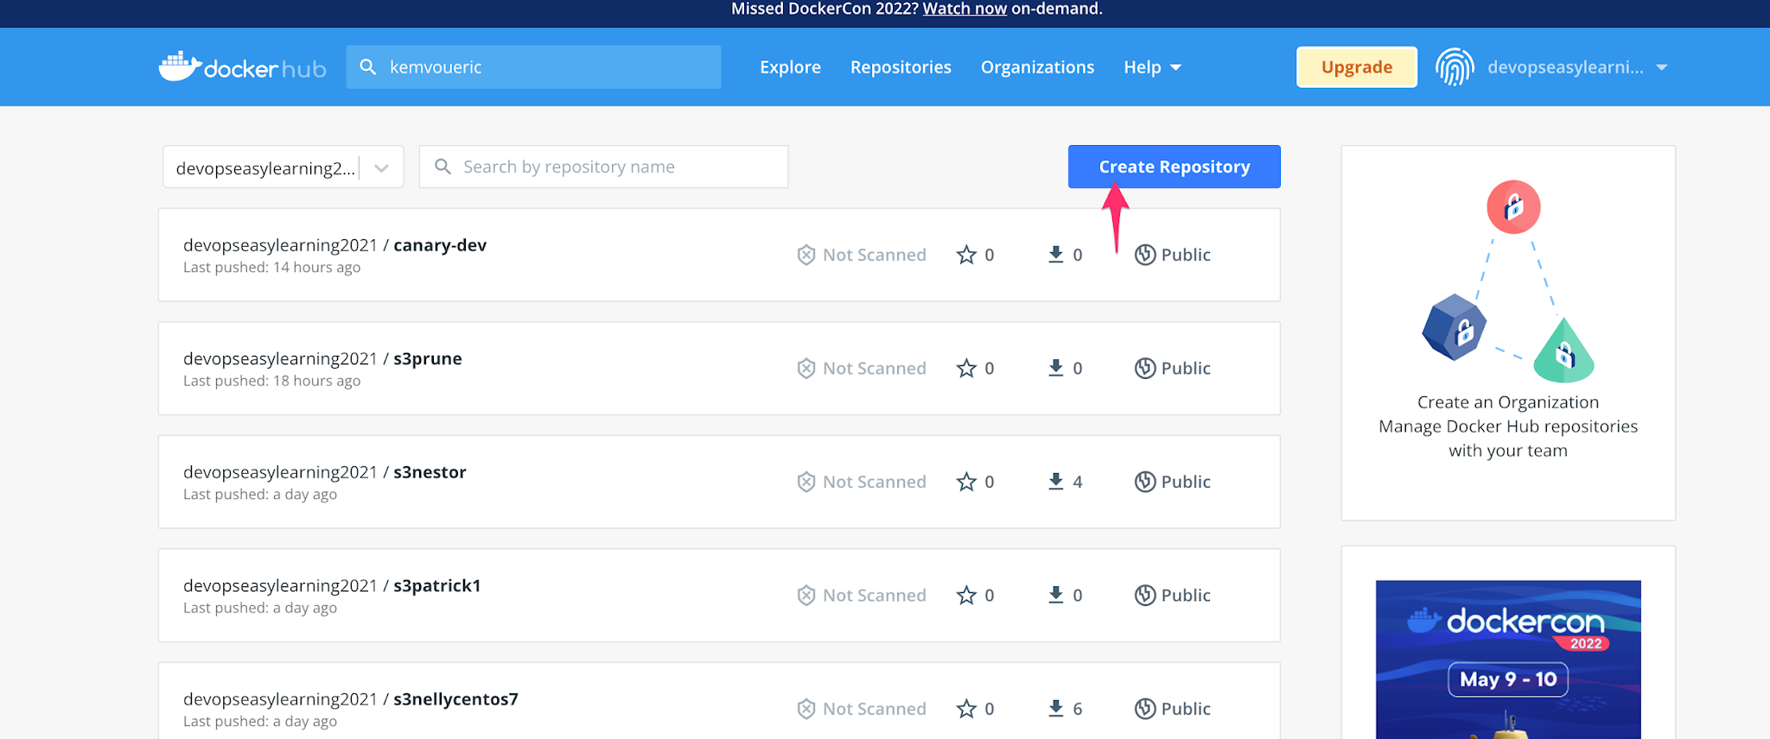
How to create a repository in docker hub?
1- login to docker hub (you cannot create a repository if you are not login into an account, make sense right?
2- click on “create repository”

Slide 94
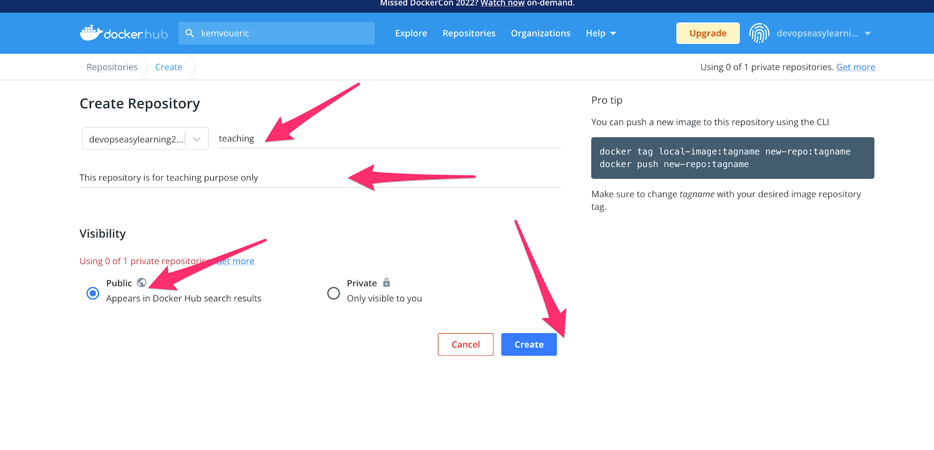
3- enter repository name
4- enter a description (optional)
5- select public
6- select create

Slide 95

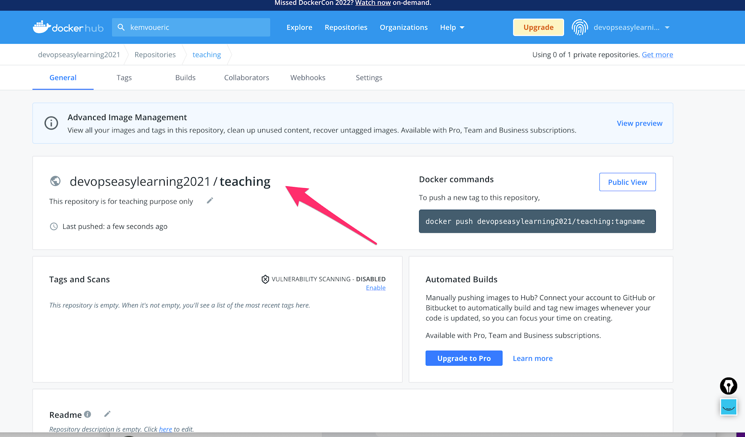

Slide 96
What is a docker private repo
In simple words private repo are repo that only authenticated user can modified or view
What is a docker public repo
In simple words public repo are repo that everyone can view (pull, explore), but only authenticated users can modify (push)
Does official repositories public or private ?
They are private repo but at the only exception that everyone can view, pull images from them
What does company used? Private or public repo
They use private repository because they don’t people to have a hold of their image

Slide 97
Is docker free to use ?
In docker all public repo are free, but there is a pull limit of 100 images every six hours
In docker private repo are not free docker will charge you for it.
GOOD NEWS docker offer one (1) free private repo per free account. It isn’t that beautiful?
How to push official image to dockerhub ?
Official images are maintained by certified and trusted companies as an individual you CAN’T push to an official repository?
Interview trap question:
Can you push an image to an official repo?
I guess by now you know the answer
NO

Slide 98

How to push NON official image to dockerhub ?
1- make sure the image you are trying to push has the correct structure (username of the account you will be pushing into if not you can tag it )
As you can see all my images are officials I can’t push them, so we have to tag correctly

Slide 99




Slide 100


2- login to dockerhub this time from our terminal
$ docker login
3- push to docker hub
$ docker push [username]/[repository name]:[tag]
$ docker push devopseasylearning2021/teaching:001
The password is hidden

Slide 101


4- check dockerhub
$ docker push [username]/[repository name]:[tag]

Slide 102
Working With Docker Images

Slide 103
Workflow

Slide 104
Docker Login
Docker login is used to login into docker registry. For docker hub, make sure to enter your username and password when prompted.
Login into Docker Hub
$ docker login
Using Amazon ECR with the AWS CLI
Login into AWS ECR
aws ecr get-login-password --region <your-region> | docker login --username AWS --password-stdin <ECR-REPOSITORY-URI>
aws ecr get-login-password --region region | docker login --username AWS --password-stdin aws_account_id.dkr.ecr.region.amazonaws.com
$ aws ecr get-login-password --region us-east-1 | docker login --username AWS --password-stdin 788210522308.dkr.ecr.us-east-1.amazonaws.com/aws-ecr-docker

Slide 105

Docker Pull
Docker pull command is use to pull image or download image from the docker repository. When the command is applied, docker perform the following action(s)
1- check if the image exist locally first
2- if the image does not exist locally, docker will pull (download) that image from dockerhub and store it local and will not perform and further action
1- docker called the docker client
2- pull action to perform which means in other word download
3- ubuntu is the repository
4- latest is the image tag to pull
1
2
3
$ docker pull ubuntu
$ docker pull [repository]:[image tag]
$ docker pull ubuntu:latest
4

Slide 106
Docker Pull
Docker pull command is use to pull image or download image from the docker repository. When the command is applied, docker perform the following action(s)
1- check if the image exist locally first
2- if the image does not exist locally, docker will pull (download) that image from dockerhub and store it local and will not perform and further action
1- docker called the docker client
2- pull action to perform which means in other word download
3- ubuntu is the repository
4- 22.10, 20.04 are the image tags to pull
1
2
3
4
$ docker pull [repository]:[image tag]
$ docker pull ubuntu:22.10
$ docker pull ubuntu:22.04

Slide 107
Docker Pull
Docker pull command is use to pull image or download image from the docker repository. When the command is applied, docker perform the following action(s)
1- check if the image exist locally first
2- if the image does not exist locally, docker will pull (download) that image from dockerhub and store it local and will not perform and further action
1- docker called the docker client
2- pull action to perform which means in other word download
3- ubuntu and centos is the repository
PS: If you don’t specify the image tag to download docker will pull the latest image tag
$ docker pull [repository]:[image tag]
1
2
3
$ docker pull ubuntu
docker will pull ubuntu:latest
$ docker pull centos
docker will pull ubuntu:latest

Slide 108
Docker Pull
1- docker : called the docker client
2- pull: action to perform which means in other word download
3- devopseasylearning202: docker hub username
4- tia: docker hub repository
5- httpd-0.3: image tag
Docker pull command is use to pull image or download image from the docker repository. When the command is applied, docker perform the following action(s)
1- check if the image exist locally first
2- if the image does not exist locally, docker will pull (download) that image from dockerhub and store it local and will not perform and further action
PS: Here, we are pulling images from our own personal repository from docker hub
$ docker pull [repository]:[image tag]
1
2
3
4
5
$ docker pull devopseasylearning2021/tia:httpd-0.3

Slide 109
Docker Pull
Docker pull command is use to pull image or download image from the docker repository. When the command is applied, docker perform the following action(s)
1- check if the image exist locally first
2- if the image does not exist locally, docker will pull (download) that image from dockerhub and store it local and will not perform and further action
1- docker : docker client
2- pull: action to perform which means in other word download
3- 7210527308.dkr.ecr.us-east-1.amazonaws.com: docker hub username
4- aws-ecr-docker: docker hub repository
5- covid19: image tag
PS: Here, we are pulling images from our own personal repository from docker hub
1
2
3
4
5
$ docker pull 7210527308.dkr.ecr.us-east-1.amazonaws.com/aws-ecr-docker:covid19

Slide 110

n
1- Repository names
2- Image tag or image name
3- Images ID. It is unique
4- The date that images were created
5- Images size
6- Docker client
7- Action to perform which means in other words display all images
Docker Images
Docker images command is use to list all images that you have locally on docker host
6
7
$ docker images
1
2
3
4
5

Slide 111
list all existing images
1- docker called the docker client
2- images action to perform which means in other words display all images
1
2
$ docker images
PS: the command is
$ docker images. and NOT $ docker image

Slide 112
Rename an image
$ docker tag [source image]:[tag] [destination image]:[tag]
docker will make a copy on the source image with the name given on the destination image
Source image and tag
Destination image and tag
$ docker tag nginx:latest eric:001

Slide 113

Rename an image
Here is the new image

Slide 114
Remove an existing image(s)
To Remove an image or images means that docker will perform the following actions
1- check if the image exist
2- if the image exist docker will remove it from Docker host
$ docker rmi -f [repository]:[image tag]
$ docker rmi -f centos
The above command will remove the latest centos image
You can remove multiple images at the same time
1- docker called the docker client
2- action to perform
3- repository from which the image will be removed
4- specific image tag to remove
1
2
3
$ docker rmi -f ubuntu
or
$ docker rmi –f ubuntu:latest
$ docker rmi -f ubuntu:20.04
$ docker rmi -f [repository]:[image tag]
4

Slide 115
Delete or remove all images not being used
$ docker images prune -a –f
Docker will remove ALL images not being used
PS: This command is very dangerous.
Make sure you know what you are doing before you run such command
$docker rmi –f $(docker images –aq)
Docker will remove ALL images that are not being used

Slide 116
Remove existing image(s) with force
1- docker: docker client
2- action to perform
3- repository from which the image will be removed
4- specific image tag to remove
-f means force and remove the image even if it is been used by a container
To Remove an image or images means that docker will perform the following actions
1- check if the image exist
2- if the image exist docker will remove it from your virtual machine
$ docker rmi –f [repository]:[image tag]
1
2
3
$ docker rmi –f [repository]:[image tag]
$ docker rmi -f ubuntu
or
$ docker rmi -f ubuntu:latest
$ docker rmi -f ubuntu:20.04
4

Slide 117
Remove multiple image(s)
To Remove an image or images means that docker will perform the following actions
1- check if the image exist
2- if the image exist docker will remove it from your virtual machine
$ docker rmi -f [repository]:[image tag] [repository]:[image tag] …………………………. [repository]:[image tag]
$ docker rmi -f ubuntu:20.04 centos redis:7.0.0 node postgres mysql
PS: you can also remove multiple images as one with the image ID
$ docker rmi -f [image_id]
$ docker rmi -f [image_id] [image_id] [image_id] …………….[image_id]

Slide 118
Working With Docker Containers

Slide 119
Run containers in interactive mode
1- docker client
2- action to perform. -it means interactive terminal in order words, it means take me inside the container and give me a terminal so that I can interact or run commands
3- repository from which the image will be pulled
4- specific image tag to use
5- bash or sh is the first command to run when the container start
When performing the docker run run command the following will happened
1- docker will pull the image if it does not exist locally
2- start a new container with the requested image
3- log you inside the container
$ docker run -it [ repository]:[image tag] [command]
1
2
3
4
5
$ docker run -it [ repository]:[image tag] [command]
$ docker run -it ubuntu:20.04 bash
$ docker run -it ubuntu:20.04 sh

Slide 120

Run a Container Interactively
Docker allows you to run a container in interactive mode. This means you can execute commands inside the container while it is still running. By using the container interactively, you can access a command prompt inside the running container.
Command to run
it notices the image does not exist locally
Pulling the image
At this point you are inside the container
Container id
The user inside the container, by default the user is always root

Slide 121

Run containers in interactive mode: exit a container
Command
Notice that you are back inside your virtual machine
PS: The exit command will kill or shutdown the container
You can also exit the container and keep it up and running with the below command
ctrl+p ctrl+q
You should press ctrl and it down, press on p and q

Slide 122
Run containers in interactive mode with container name assigned
1- docker client
2- action to perform. -it means interactive terminal in order words, it means take me inside the container and give me a terminal so that I can interact or run commands
3- --name: the argument telling docker that we want to specified the container name
4- eric the name of the container. It can be any name even your own name
5- repository from which the image will be pulled
6- specific image tag to use
7- bash or sh is the first command to run when the container start
$ docker run –it –name [specify a single name] [repository]:[image tag] [command]
4
5
6
2
3
7
1
$ docker run –it --name eric ubuntu:20.04 bash
$ docker run -it n --name eric ubuntu:20.04 sh

Slide 123
Run containers in interactive mode and create an environment variable
$ docker run –it –e [key]=[value] [repository]:[image tag] [command]
Docker will create the environment variable specified if it does not exist
1- -e telling docker you want to create an environment variable
2 and 3 create the environment variable inside the container
2
3
1
$ docker run -it -e COUNT=50 ubuntu:20.04 bash
$ docker run -it -e DEVOPS=money -e A=jobs ubuntu:20.04 bash
PS: you can create multiple env variable at the same time

Slide 124

Run the Command to Check the env
Launch a container with env variable
Let us run the command env inside the container
As you can see the variable we specified at the runtime is there
Let us print that variable using the echo command
output

Slide 125
Run containers in interactive mode and set a working directory
$ docker run –it –w [specify a directory inside the container] [repository]:[image tag] [command]
Docker start the container and set your current working directory to the the directory you specified
PS: The directory must exist first docker will NOT create it
1- -w tells docker you want set working directory
2 /home will be the current directory when the container start
2
1
$ docker run -it -w /home ubuntu:20.04 bash
$ docker run -it -w /opt ubuntu:20.04 bash
PS: you can only specify one working directory

Slide 126
Notice here I did not specified the working directory and docker set my home directory to the top level directory (/) by default
Notice here my current working directory is ”/home” which is the one I specified on the command

Slide 127
Assigning a Port Mapping to a Docker Container
Port mapping is used to access the services running inside a Docker container. We open a host port to give us access to a corresponding open port inside the Docker container. Then, all the requests that are made to the host port can be redirected into the Docker container.
Port mapping makes the processes inside the container available from the outside.
While running a new Docker container, we can assign the port mapping in the docker run command using the -p option

Slide 128
Run containers in interactive mode and open a port
$ docker run –it -p [port on your VM]=[port inside the container ] [repository]:[image tag] [command]
Docker will map a port from your VM to a port inside the container
-p telling docker you want to map to a port inside a container
87 port on your VM that you want to map with another port inside the container
80 port exposed inside the container that you want to map with another port on your virtual machine
2
1
3
$ docker run -it -p 87:80 nginx bash
$ docker run -it -p 50:80 -p 89:8080 ubuntu:20.04 bash
PS: you can open multiple ports at the same time

Slide 129
Using multiple arguments on interactive mode
All arguments can be used at once under a single command in docker:
$ docker run -it --name devops -w /home -e DEVOPS=money -v $PWD:/vol -p 85:81 nginx bash
Docker detached mode (-d)
Detached mode, shown by the option --detach or -d, means that a Docker container runs in the background of your terminal. It does not receive input or display output.
In other words detach mode means that docker will not log or or take you inside the container when it start.
$ docker run -d --name devops nginx bash
$ docker run -d -e DEVOPS=money nginx bash
$ docker run -d -v $PWD:/vol nginx bash
$ docker run -d -p 85:81 nginx bash
$ docker run -d --name devops -w /home -e DEVOPS=money -v $PWD:/vol -p 85:81 nginx bash

Slide 130
Notice that I am still inside my VM
The container was created and there is the container ID
command
As we can all see the –d flag will create the container but will not log or take you inside the container

Slide 131
Using multiple arguments on interactive detach mode
All arguments can be used at once under a single command in docker
docker run -itd --name devops -w /home -e DEVOPS=money -v $PWD:/vol -p 85:81 nginx bash
Notice that I am still inside my VM
The container was created and there is the container ID
Command
As we can all see the –itd flag will create the container but will not log or take you inside the container as well

Slide 132

Logging into a running containers
$ docker exec –it [container name or container ID] bash
Or
$ docker exec –it [container name or container ID] sh
Docker take you inside the running container
Let us list all running containers first
command
I am now inside the container
To leave a container once you are inside just type the command $exit

Slide 133

How to run a command in a running container without login inside
$ docker exec –it [container name or container ID] [command]
Docker will NOT take you inside the running container but will run the indicated command for you

Slide 134

How to run multiple commands in a running container without login inside
$ docker exec –it [container name or container ID] bash –c “ [command 1] ; [command 2] …….. ; [command n]
Docker will NOT take you inside the running container but will run the indicated commands for you
Notice that commands are separated by a semicolon (;)

Slide 135

List all running containers
$ docker ps
Docker display all running containers ONLY
Notice that all container status are “UP” meaning they are in running state

Slide 136

List all containers (Running and exited containers)
$ docker ps -a
Docker display all containers
Notice that all container status are “UP or Exited” meaning “docker ps –a” will display all

Slide 137

Delete or remove containers
Notice that I was able to remove containers by names or ID
If you want to use containers ID you can use only the first few digit of the container ID
$docker rm –f 415ddcfg415
Will work same as
$docker rm 415
$ docker rm –f [ container name] …………….. [ container name]
Or
$ docker rm –f [ container ID] …………….. [ container ID]
Docker will remove indicated containers

Slide 138
Stop running container(s)
$ docker stop [ container name] …………….. [ container name]
$ docker stop [ container ID] …………….. [ container ID]
Docker will stop indicated containers
To stop a container, use the docker stop command with either the container id or container name.
$ docker stop f8c52bedeecc
$ docker stop f8c52bedeecc dgfbfhsb dhdd ddddd
$ docker stop ubuntu httpd msql

Slide 139
start stopped container(s)
$ docker start [ container name] …………….. [ container name]
$ docker start [ container ID] …………….. [ container ID]
Docker will start indicated containers
To start a container, use the docker start command with either the container id or container name.
$ docker start f8c52bedeecc
$ docker start f8c52bedeecc dgfbfhsb dhdd ddddd
$ docker start ubuntu httpd msql

Slide 140
restart stopped or running container(s)
$ docker start [ container name] …………….. [ container name]
$ docker start [ container ID] …………….. [ container ID]
Docker will restart indicated containers
To restart means, stop first then start
We can restart a single or multiple containers
$ docker restart f8c52bedeecc
$ docker restart f8c52bedeecc dgfbfhsb dhdd ddddd
$ docker restart ubuntu httpd msql

Slide 141
Check the log of a container
$ docker logs [ container name]
$ docker logs [ container ID]
Docker will display the log of indicated container
This command is helpful to debug our Docker containers. It will fetch logs from a specified container.
$ docker logs f8c
$ docker logs httpd
Check the log of a container in real time
$ docker logs -f [ container name]
$ docker logs –f [ container ID]
Docker will display the log of indicated container in real time
$ docker logs -f f8c
$ docker logs -f ryann

Slide 142
Delete or remove ALL exited containers
$ docker container prune –f
Docker will remove ALL exited containers
PS: This command is very dangerous make sure you know what you are doing before you run such command
Delete or remove ALL containers
docker rm –f $(docker ps –aq)
Docker will remove ALL containers

Slide 143

Create volumes, list all volumes
To list all volume
$ docker volume ls
$ docker volume create [volume name]
Docker will create a volume with the name provided
$ docker volume create vol
$ docker volume create ansible
$ docker volume create volumes
Where are docker volumes located?
/var/lib/docker/volumes

Slide 144
Remove ALL volumes NOT being used
$ docker volume prune –f
Docker will remove all volumes that are not being used
PS: This command is very dangerous make sure you know what you are doing before you run such command
Delete or remove all volumes
docker volume rm –f [volume name 1 ]…….. [volume name ]
Docker will remove ALL volume
$ docker volume rm –f vol ansible vol

Slide 145
Delete all volumes, images, containers network not being used
$ docker system prune –f –a
Docker will remove all entities NOT being used
PS: This command is very dangerous make sure you know what you are doing before you run such command
$ docker system prune –f –a

Slide 146
Docker save and docker load
Pull 2 images down
docker pull ubuntu
docker pull centos
Save one image to tar file
docker save ubuntu > ubuntu.tar
docker export ubuntu > ubuntu.tar
docker load < ubuntu.tar
Imagine a scenario where you have built Docker images and containers that you would be interested to keep and share it with your other collaborators or colleagues. The below methods shall help you achieve it.
Four basic Docker CLI comes into action:
The docker export: Export a container’s filesystem as a tar archive
The docker import: Import the contents a container’s and create a filesystem image
The docker save: Save one or more images to a tar archive
The docker load: Load an image from a tar archive
What is the difference between save and export in Docker?

Slide 147
Docker Commit
When working with Docker images and containers, one of the basic features is committing changes to a Docker image. When you commit to changes, you essentially create a new image with an additional layer that modifies the base image layer.
sudo docker commit [CONTAINER_ID] [new_image_name]
sudo docker commit deddd39fa163 ubuntu-test
How to Commit Changes to a Docker Image with Examples

Slide 148
Volume In Docker

Slide 149

What is a Docker Volume?
Type of volume in Docker
We have two types of volume in docker
Volume mount: This mount the volume from the volume directory in docker host in /var/lib/docker/volumes/. Please Do not mess up with this directory because it is been managed by Docker daemon.
Bind mount: mount a directory from any location on docker host such as HDD or in the directory on the HDD or mount a directory from any location such as HDD or in the directory on the HDD

Slide 150
Volume Types In Docker
Docker volume is to share data between the container and the host so that if something happens to the container, we can launch another container and attach the same volume into it. It is used to share data between multiple containers at the same time.
Example: let say your a file to copy between 200 container, you can just create a volume and share between those 200 containers
NB: We can mount volume only on new launch containers and not running containers
Docker volume = mount point in linux = share file or network file in windows

Slide 151
Volume In Docker
Difference between volumes mount and bind mount
Volumes mount are managed by docker daemon because they are mounted from the default docker home /var/lib/docker while bind mount are managed by the file system of the server, and it can be mounted anywhere on docker host.
Pros of docker volumes
Data will be consistent on the host even if the container is deleter
The same volume can be attach multiple containers at the same time
Data will be in sync
Data will be data sharing between the host and container

Slide 152
Run containers in interactive mode and attach a volume
1- docker client
2- action to perform. -it means interactive terminal in order words, it means take me inside the container and give me a terminal so that I can interact or run commands
3- -v argument is telling docker we want to attach a volume locate inside the container
4- $PWD telling docker to use our current directory as volume
5- /vol volume locate inside the container
6- repository from which the image will be removed
7- specific image tag to use
8- bash or sh is the first command to run when the container start
$ docker run –it –v [volume locate in your VM]:[volume located inside the container] [repository]:[image tag] [command]
If you want to use the current directory located in your VM as volume use ”$PWD”
6
7
2
3
4
5
1
8
$ docker run -it -v $PWD:/vol ubuntu:20.04 bash
PS: you can mount or attach multiple volumes at the same time

Slide 153

I am running this command on my VM
output
This command will create a container and attach my current directory as a volume inside the container located at /vol
Let us see what is inside /vol inside the container
Output same as above
The volume in docker is very important because it allows you to mount files and directories from your local VM to the container and if any of these directories or files are modified either from your VM or inside the container they will be reflect on both sides (container and VM)

Slide 154
Volume In Docker
wget https://linux-devops-course.s3.amazonaws.com/WEB+SIDE+HTML/covid19.zip
unzip covid19.zip
cp -R covid19/* .
rm -rf covid19.zip
rm -rf covid19
docker run -it -d -p 8084:80 --name httpd_tia -v "$PWD":"/usr/local/apache2/htdocs/" --workdir "/usr/local/apache2/htdocs/" httpd
docker run -it -d \
-p 8083:80 \
--name httpd_tia \
-v "$PWD":"/usr/local/apache2/htdocs/" \
--workdir "/usr/local/apache2/htdocs/" \
httpd
docker run -it --rm \
-v "$PWD":"/code" \
--workdir "/code" \
ubuntu
docker run --rm \
-v "$PWD":"/code" \
--workdir "/code" \
ubuntu cat /etc/*release
docker run --rm \
-v "$PWD":"/python" \
--workdir "/python" \
python \
python python.py
docker run --rm \
-v "$PWD":"/code" \
--workdir "/code" \
ubuntu bash script.sh
docker run -it --rm \
-v "$PWD":"/awscli" \
--workdir "/awscli" \
organs/awscli

Slide 155
Port Forward In Docker

Slide 156

Port Forwarding In Docker
What is Port Forwarding in Docker?
It helps us to access an application running inside a docker container
When you run a docker container, Your containers will be on one network call private accelety network and docker engine on another network same as you host machine
The default behavior here is that whatever is running inside the container cannot be access from the host for security concern
We have 3 types of port forwarding in docker
Not port forwarding
Free port forwarding
Binding port forwarding

Slide 157

Port Forwarding In Docker

Slide 158



Port Forwarding In Docker

Slide 159
Port Forwarding In Docker
Free port forwarding
In this case, docker will automatically assign a random range from 30000-65535
$ docker run -d -P nginx
$ docker run -d -P leonardtia/devops-pro-repos:covid19

Slide 160
Port Forwarding In Docker
Not port forwarding
The container will not be accessible from outside.
$ docker run -d nginx

Slide 161
Port Forwarding In Docker
Binding port forwarding
PS: To bind a port, the port most be expose in the docker file In this case, we can specify a particular port that we want to use.
$docker run -d -p 8888:80 nginx
$ docker run -d -p 8889:80 leonardtia/devops-pro-repos:covid19

Slide 162
Network in Docker

Slide 163

Why Networking In Docker?
Docker Networking is to connect the docker container to each other and outside world so they can communicate with each other also they can talk to Docker Host. Docker uses CNM Container Network Model for networking. This model standardizes the steps required to provide networking for containers using multiple network drivers

Slide 164
Network Types In Docker
We have 4 types of network in Docker:
Bridge Networking (This is the default network in Docker)
Host Networking
Overlay Networking

Slide 165

Bridge Network
Bridge network is a default network that get created automatically when you deploy a container
The bridge network creates a private internal isolated network to the host so containers on this network can communicate.
This network allows us to see our application outside the work. Or it expose our application outside the world

Slide 166

Bridge Network
Bridge network is a default network that get created automatically when you deploy a container
The bridge network creates a private internal isolated network to the host so containers on this network can communicate.
This network allows us to see our application outside the work. Or it expose our application outside the world

Slide 167

Host Network
Docker network host, also known as Docker host networking, is a networking mode in which a Docker container shares its network namespace with the host machine
This network allows does not us to see our application outside the work. Or to expose our application outside the world
If you network is type host, you will not be able to see you application outside the world

Slide 168

Overlay Network
The overlay network driver creates a distributed network among multiple Docker daemon hosts.
It allows containers connected to it to communicate securely when encryption is enabled
This type of network is only used in docker swarm

Slide 169

Overlay Network

Slide 170
Dockerfile

Slide 171
Workflow

Slide 172
What is a Dockerfile?
A Dockerfile is a text file that carry out all the instructions to build a custom image

Slide 173
Dockerfile Naming Conventions
A Dockerfile alway start with uppercase D such as Dockerfile
When you Dockerfile start with uppercase D, we will not need to specify it through the command line while building because if you are running the build in the same location where your Dockerfile is located
If you Dockerfile name is not Dockerfile because you might have multiple Dockerfile, you file should have an extension .Dockerfile and you must pass an argument -f and the Dockerfile name through the CLI while building your image
FROM ubuntu
LABEL maintainer="Tia M"
RUN apt -y update && \
apt -y install wget && \
apt -y install unzip
$ docker build -t <image_name> -f <path><mycustomdockerfile>.Dockerfile .
$ docker build -t <image_name> . -f <path><mycustomdockerfile>.Dockerfile

Slide 174
Dockerfile Naming Conventions
1- Docker client
2- Action to perform which means in other words build the image
Image tag or image name
3- Specify the tag
4- Tag name
5- Specify the file path
6- Path to the file
7- Dockerfile name
8- Means the Dockerfile is here
FROM ubuntu
LABEL maintainer="Tia M"
RUN apt -y update && \
apt -y install wget && \
apt -y install unzip
1
2
3
4
5
6
7
8
$ docker build -t <image_name> -f <path><mycustomdockerfile>.Dockerfile .
$ docker build -t <image_name> . -f <path><mycustomdockerfile>.Dockerfile

Slide 175
Dockerfile Naming Conventions
docker build -f dockerfiles/dev.Dockerfile -t dev_app .
docker build -f dockerfiles/qa.Dockerfile -t aq_app .
docker build -f dockerfiles/prod.Dockerfile -t prod_app .
docker build -t dev_app . -f dockerfiles/dev.Dockerfile
docker build -t aq_app . -f dockerfiles/qa.Dockerfile
docker build -t prod_app . -f dockerfiles/prod.Dockerfile
FROM ubuntu
LABEL maintainer="Tia M"
RUN apt -y update && \
apt -y install wget && \
apt -y install unzip
$ docker build -t <image_name> -f <path><mycustomdockerfile>.Dockerfile .
$ docker build -t <image_name> . -f <path><mycustomdockerfile>.Dockerfile

Slide 176
Dockerfile Naming Conventions
docker build -t dev_app . -f dockerfiles/dev.Dockerfile
docker build -t aq_app . -f dockerfiles/qa.Dockerfile
docker build -t prod_app . -f dockerfiles/prod.Dockerfile
docker build -t dev_app -f dockerfiles/dev.Dockerfile .
docker build -t aq_app -f dockerfiles/qa.Dockerfile .
docker build -t prod_app -f dockerfiles/prod.Dockerfile .
FROM ubuntu
LABEL maintainer="Tia M"
RUN apt -y update && \
apt -y install wget && \
apt -y install unzip
$ docker build -t <image_name> -f <path><mycustomdockerfile>.Dockerfile .
$ docker build -t <image_name> . -f <path><mycustomdockerfile>.Dockerfile

Slide 177
Dockerfile Naming Conventions
docker build -t dev_app -f dev/Dockerfile .
docker build -t dev_app -f qa/Dockerfile .
docker build -t dev_app -f prod/Dockerfile .
cd dev && docker build -t dev_app .
cd qa && docker build -t dev_app .
cd prod && docker build -t dev_app .
FROM ubuntu
LABEL maintainer="Tia M"
RUN apt -y update && \
apt -y install wget && \
apt -y install unzip
$ docker build -t <image_name> -f <path><mycustomdockerfile>.Dockerfile .
$ docker build -t <image_name> . -f <path><mycustomdockerfile>.Dockerfile

Slide 178


Docker Layer Explain
Layers
Layers are what make up an image. Each layer is a “diff” that contains the changes made to the image since the last one was added. When building an image, the platform creates a new layer for each instruction in the file. The container starts at the first instruction in the file and executes all instructions in order. The first instruction might install packages, while later instructions might copy files or create directories

Slide 179

Docker Layer Explain
Imagedb
The imagedb is an image database that stores information about the Docker layers and the relationships between them (for example, how one depends on the other). The Docker daemon stores the imagedb. The daemon is the process that runs on the host machine and manages containers. When running a container, the platform uses this database to retrieve information about each layer.

Slide 180
Docker Layer Explain
Layerdb
The layerdb is a database that holds information about the relationship between layers. It also holds instructions for building layers. This database is stored in the daemon. When running a container using an image, the Docker daemon uses both the imagedb and layerdb to start the container.

Slide 181
Docker Layer Explain
Cache
The cache speeds up the process of building an image. It stores all the files that make up each layer in a database called "layer cache database." Each file has a hash value and a row in this database. Each Docker layer also has a row in the cache database

Slide 182
Docker Layer Explain
Docker Layers: Putting It All Together
Now that we’ve seen the architecture behind Docker layers, let’s look at how everything works together. Building layers consists of four major components:
Dockerfile, which is a file that contains the commands or instructions to build layers.
Imagedb, which stores images in registries like Docker Hub.
Layerdb for storing the current working state of layers as they are built at each command from Dockerfile. The layerdb maintains layer history and generates diffs between the layers.
Caches store objects or files for images so they can be cached to speed up retrieval time.

Slide 183

Docker Layer Explain

Slide 184


Docker Layer Explain

Slide 185
Way to Create a Custom Images
They are 2 ways to create a custom images
From a running container (snapshot of a running container at a particular time)
From Dockerfile (standard way use by companies out there)
docker commit [CONTAINER_ID] [new_image_name]
docker commit deddd39fa163 ubuntu-commit
https://phoenixnap.com/kb/how-to-commit-changes-to-docker-image

Slide 186

All Dockerfile Instructions
FROM
ADD
COPY
CMD
ENTRYPOINT
ENV
EXPOSE
MAINTAINER
RUN
USER
VOLUME
WORKDIR
LABEL
ARG

Slide 187
FROM ubuntu:latest
ARG JENKINS_HOME=/var/jenkins_home
ENV TIA_HOME /var/tia/devops
ARG user=jenkins
ARG http_port=8080
LABEL maintainer="devopseasylearning.com"
LABEL build_date="2017-09-05"
MAINTAINER Tia
USER root
ADD /covid19/* /var/www/html/
COPY /covid19/* /var/www/html/
ADD https://warfiles-for-docker.s3.amazonaws.com/addressbook.war /usr/local/tomcat/webapps/
RUN apt -y update && \
apt -y install wget && \
apt -y install unzip
WORKDIR /var/www/html/
WORKDIR /usr/local/apache2/htdocs
VOLUME $JENKINS_HOME
USER ${user}
EXPOSE ${http_port}
ENTRYPOINT ["/bin/bash", "-c", "script.sh"]
CMD ["/bin/bash", "-c", "script.sh"]
All Dockerfile Instructions
FROM
ADD
COPY
CMD
ENTRYPOINT
ENV
EXPOSE
MAINTAINER
RUN
USER
VOLUME
WORKDIR
LABEL
ARG

Slide 188

FROM Instructions
The Dockerfile FROM command specifies the base image of your Docker images.
A base image is the image that is used to create all of your container images. Your base image can be an official Docker image, such as Centos, or you can modify an official Docker image to suit your needs, or you can create your own base image from scratch.
FROM ubuntu:latest

Slide 189
LABEL Instructions
The Dockerfile LABEL instruction allows you to add a label or metadata to your docker image.
LABEL maintainer="devopseasylearning.com"
LABEL build_date="2017-09-05"

Slide 190
MAINTAINER Instructions
The Dockerfile MAINTAINER instruction has been deprecated dockerfile and it has been replaced by LABEL instruction instead.
FROM ubuntu
MAINTAINER Tia
RUN apt-get update -y
CMD ["/bin/bash", "-c", "uname -a"]

Slide 191
RUN Instructions
The Dockerfile RUN instruction is executed during build time of the Docker image, so RUN commands are only executed once. The RUN command can be used to extract files, to download files, to install packages, to run all shell command or other command line activities which are necessary to run while building the docker image.
RUN cd /usr/local/apache2/htdocs
RUN rm -rf *
RUN wget https://linux-devops-course.s3.amazonaws.com/WEB+SIDE+HTML/covid19.zip
RUN unzip covid19.zip
RUN cp -R covid19/* .
RUN rm -rf covid19.zip
RUN rm -rf covid19
OR
RUN cd /usr/local/apache2/htdocs && \
rm -rf * && \
wget https://linux-devops-course.s3.amazonaws.com/WEB+SIDE+HTML/covid19.zip && \
unzip covid19.zip && \
cp -R covid19/* .
rm -rf covid19.zip && \
rm -rf covid19 && \
RUN apt -y update
RUN apt -y install wget
RUN apt -y install unzip
OR
RUN apt -y update && \
apt -y install wget && \
apt -y install unzip

Slide 192
ADD Instructions
ADD index.html /var/www/html/
ADD /covid19/* /var/www/html/
ADD https://warfiles-for-docker.s3.amazonaws.com/addressbook.war /usr/local/tomcat/webapps/
ADD ./* .
WORKDIR /myapp/
ADD . .
ADD ./* /myapp/
ADD . /myapp/
The Dockerfile ADD instruction works in the same way as the COPY instruction with a few minor differences:
The ADD instruction can copy and extract TAR files from the Docker host to the Docker image.
The ADD instruction can download files via HTTP and copy them into the Docker image.
Here are a few Dockerfile ADD examples:

Slide 193
COPY Instructions
COPY ./* .
WORKDIR /myapp/
COPY . .
COPY ./* /myapp/
COPY . /myapp/
The Dockerfile COPY command copies one or more files from the Docker host (the computer building the Docker image from the Dockerfile) into the Docker image. The COPY command can copy both a file or a directory from the Docker host to the Docker image. Here are some Dockerfile COPY examples
COPY /myapp/target/myapp.jar /myapp/myapp.jar
This example copies a single file call myapp.jar from the Docker host at /myapp/target/myapp.jar to the Docker image at /myapp/myapp.jar. The first argument is the Docker host path (where to copy from) and the second argument is the Docker image path (where to copy to).
COPY /myapp/target/* /myapp/
This example copies all files and directories from the Docker host at /myapp/target/ to the Docker image at /myapp/. The first argument is the Docker host path (where to copy from) and the second argument is the Docker image path (where to copy to).

Slide 194
WORKDIR Instructions
The WORKDIR instruction specifies what the working directory should be inside the Docker image. The working directory will be in effect for all commands following the WORKDIR instruction.
Here is an example:
WORKDIR /tmp
WORKDIR /var/www/html/
WORKDIR /usr/local/apache2/htdocs

Slide 195
EXPOSE Instructions
The Dockerfile EXPOSE instruction opens up network ports in the Docker container to the world. For instance, if your Docker container runs a web server, that web server will probably need port 80 or 8080 open for any client to be able to connect to it. Here is an example of opening a network port using the EXPOSE command:
EXPOSE 8080
EXPOSE 80

Slide 196
VOLUME Instructions
The Dockerfile VOLUME instruction creates a directory inside the Docker image which you can later mount a volume (directory) to from the Docker host. In other words, you can create a directory inside the docker image, called /data which can later be mounted to a directory, called /container-data/container1 in the Docker host. The mounting is done when the container is started up and it is use to share data between the container and the host. Here is an example of defining a volume (mountable directory) in a Dockerfile using the VOLUME instruction:
VOLUME /data

Slide 197
USER Instructions
The Dockerfile USER instruction sets username of the user which is to run the container. By default, containers run as root.
USER root

Slide 198

ENV Instructions
The Dockerfile ARG instruction lets you define an argument which can be passed to Docker when you build the Docker image from the Dockerfile. ARG works the same as variable. It is like defining a variable in Dockerfile.
ARG user=jenkins
ARG group=jenkins
ARG http_port=8080
ARG JENKINS_HOME=/var/jenkins_home
ENV TIA_HOME /var/tia/devops
RUN mkdir -p $JENKINS_HOME \
&& chown ${user}:${user} $JENKINS_HOME \
&& groupadd ${group} \
&& useradd -d "$JENKINS_HOME" -s /bin/bash ${user} \
&& usermod -aG ${user} ${group} \
VOLUME $JENKINS_HOME
USER ${user}
EXPOSE ${http_port}

Slide 199
ENV Instructions
The Dockerfile ENV instruction lets you set and environment variable to be used by the system. The is a system variable and not a use define variable. The command env will list all environment variables in Linux.
ARG user=jenkins
ARG group=jenkins
ARG http_port=8080
ARG JENKINS_HOME=/var/jenkins_home
ENV TIA_HOME /var/tia/devops
RUN mkdir -p $JENKINS_HOME \
&& chown ${user}:${user} $JENKINS_HOME \
&& groupadd ${group} \
&& useradd -d "$JENKINS_HOME" -s /bin/bash ${user} \
&& usermod -aG ${user} ${group} \
VOLUME $JENKINS_HOME
USER ${user}
EXPOSE ${http_port}

Slide 200

CMD Instructions
The Dockerfile CMD instruction is used to execution commands when the container start or during the creation of the container. We can use CMD to start the process when the container start or to run a script when the container start.
PS: We can overwrite the CMD command at run time
CMD ["script.sh"]
CMD ["/home/tia/script.sh"]
CMD ["/bin/bash", "-c", "script.sh"]
CMD ["echo", "Hello World"]
CMD ["script.sh"]
CMD ["/usr/sbin/httpd", "-D", "FOREGROUND"]
CMD ["httpd-foreground"]
CMD ["catalina.sh", "run"]

Slide 201
ENTRYPOINT Instructions
The Dockerfile ENTRYPOINT instruction is used to execution commands when the container start or during the creation of the container. We can use ENTRYPOINT to start the process when the container start or to run a script when the container start.
PS: We can overwrite the ENTRYPOINT command at run time by specifying the argument - - entrypoint
ENTRYPOINT ["script.sh"]
ENTRYPOINT ["/home/tia/script.sh"]
ENTRYPOINT ["/bin/bash", "-c", "script.sh"]
ENTRYPOINT ["echo", "Hello World"]
ENTRYPOINT ["script.sh"]
ENTRYPOINT ["/usr/sbin/httpd", "-D", "FOREGROUND"]
ENTRYPOINT ["httpd-foreground"]
ENTRYPOINT ["catalina.sh", "run"]

Slide 202

CMD Hand On
FROM ubuntu
MAINTAINER Tia
RUN apt-get update -y
CMD ["/bin/bash", "-c", "uname -a"]
sudo docker build -t cmd .
sudo docker run -it cmd:latest
sudo docker run -it cmd:latest uname -r
sudo docker run -it cmd:latest ls -la

Slide 203

ENTRYPOINT Hand On
sudo docker build -t entrypoint .
sudo docker run -it entrypoint:latest
sudo docker run -it entrypoint:latest uname -r
sudo docker run -it entrypoint:latest
sudo docker run -it entrypoint:latest uname -r - - entrypoint ls -la
sudo docker run -it entrypoint:latest - - entrypoint ls -la
FROM ubuntu
MAINTAINER Tia
RUN apt-get update -y
ENTRYPOINT ["/bin/bash", "-c", "uname -a"]

Slide 204


What is the Difference between Dockerfile, Images and Containers?

Slide 205
What is the Difference between CMD and ENTRYPOINT?

Slide 206
What is the Difference between ADD and COPY?

Slide 207
It is Possible to See All Process Running in the Container
From the Docker Host?

Slide 208
Dockerfile Examples

Slide 209
Dockerfile Examples
<!DOCTYPE html>
<html>
<body style="background-color:rgb(217, 250, 210);">
<h1>Welcome to DevOps Easy Learning</h1>
<h3>This is to test httpd Web server at devopseasylearning.com</h3>
</body>
</html>
FROM centos:latest
ARG port=80
ARG user=root
LABEL maintainer="Tia M"
RUN yum -y update && \
yum -y install httpd
COPY index.html /var/www/html/
USER ${user}
ENTRYPOINT ["/usr/sbin/httpd", "-D", "FOREGROUND"]
EXPOSE ${port}
docker build -t <username>/<repository name>:tag
docker build -t leonardtia/devops_repo:test .
docker run --name test -p 8030:80 -d leonardtia/devops_repo:test
docker login
docker push leonardtia/devops_repo:test

Slide 210
Dockerfile Examples
FROM httpd
ARG port=80
ARG user=root
LABEL maintainer="Tia M"
RUN apt -y update && \
apt -y install wget && \
apt -y install unzip
WORKDIR /usr/local/apache2/htdocs/
RUN rm -rf * && \
wget https://linux-devops-course.s3.amazonaws.com/WEB+SIDE+HTML/covid19.zip && \
unzip covid19.zip && \
cp -R covid19/* . && \
rm -rf covid19.zip && \
rm -rf covid19
USER ${user}
CMD ["httpd-foreground"]
EXPOSE ${port}
docker build -t <username>/<repository name>:tag
docker build -t leonardtia/devops_repo:covid19 .
docker run --name covid19 -p 8010:80 -d leonardtia/devops_repo:covid19
docker login
docker push leonardtia/devops_repo:covid19

Slide 211
Dockerfile Examples
FROM httpd
LABEL maintainer="Tia M"
RUN apt -y update && \
apt -y install wget && \
apt -y install unzip
WORKDIR /usr/local/apache2/htdocs/
RUN rm -rf * && \
wget https://linux-devops-course.s3.amazonaws.com/WEB+SIDE+HTML/static-website-example.zip && \
unzip static-website-example.zip && \
cp -R static-website-example/* . && \
rm -rf static-website-example.zip && \
rm -rf static-website-example
USER root
ENTRYPOINT ["httpd-foreground"]
EXPOSE 80-10000
docker build -t <username>/<repository name>:tag
docker build -t leonardtia/devops_repo:static-website-example .
docker run --name static-website-example -p 8020:80 -d leonardtia/devops_repo:static-website-example
docker login
docker push leonardtia/devops_repo:static-website-example

Slide 212
Dockerfile Examples
FROM httpd
LABEL maintainer="Tia M"
RUN apt -y update && \
apt -y install wget && \
apt -y install unzip
WORKDIR /usr/local/apache2/htdocs/
RUN rm -rf * && \
wget https://linux-devops-course.s3.amazonaws.com/WEB+SIDE+HTML/static-website-example.zip && \
unzip static-website-example.zip && \
cp -R static-website-example/* . && \
rm -rf static-website-example.zip && \
rm -rf static-website-example
USER root
ENTRYPOINT ["httpd-foreground"]
EXPOSE 80-10000
docker build -t <username>/<repository name>:tag
docker build -t leonardtia/devops_repo:static-website-example .
docker run --name static-website-example -p 8020:80 -d leonardtia/devops_repo:static-website-example
docker login
docker push leonardtia/devops_repo:static-website-example

Slide 213
Dockerfile Examples
docker build -t <username>/<repository name>:tag
docker build -t leonardtia/devops_repo:static-website-example .
docker run --name static-website-example -p 8020:80 -d leonardtia/devops_repo:static-website-example
docker login
docker push leonardtia/devops_repo:static-website-example
Access Application locally
http://<IP>:8020/
http://10.0.0.94:8020/
FROM httpd
ARG WEB_DIRECTORY=static-website-example
LABEL maintainer="Tia M"
RUN apt -y update && \
apt -y install wget && \
apt -y install unzip
WORKDIR /usr/local/apache2/htdocs/
RUN rm -rf * && \
wget https://linux-devops-course.s3.amazonaws.com/WEB+SIDE+HTML/$WEB_DIRECTORY.zip && \
unzip $WEB_DIRECTORY.zip && \
cp -R $WEB_DIRECTORY/* . && \
rm -rf $WEB_DIRECTORY.zip && \
rm -rf $WEB_DIRECTORY
USER root
ENTRYPOINT ["httpd-foreground"]
EXPOSE 80

Slide 214
Dockerfile Examples
docker build -t <username>/<repository name>:tag
docker build -t leonardtia/devops_repo:addressbook .
docker run --name addressbook -p 8050:8080 -d leonardtia/devops_repo:addressbook
docker login
docker push leonardtia/devops_repo:addressbook
http://<IP>:8050/addressbook
http://10.0.0.94:8050/addressbook
FROM tomcat
LABEL maintainer="Tia M"
ADD https://warfiles-for-docker.s3.amazonaws.com/addressbook.war /usr/local/tomcat/webapps/
ENTRYPOINT ["catalina.sh", "run"]
EXPOSE 8080

Slide 215
Install Jenkins In Docker
docker pull jenkins/jenkins:2.276
docker run -d -p 8070:8080 --name jenkins-nonprod jenkins/jenkins:2.276
http://<IP>:8070
http://10.0.0.94:8070
Unlock Jenkins
Exec into the port and, cat /var/jenkins_home/secrets/initialAdminPassword to get the password to unlock Jenkins
docker exec -it 217c7b40d0fd bash
cat /var/jenkins_home/secrets/initialAdminPassword
ctrl <p> <q>
E887a1976710453f922c1aaa50de7d47
docker exec -it 217c7b40d0fd cat /var/jenkins_home/secrets/initialAdminPassword

Slide 216
Interact with AWS ECR

Slide 217

What is ECR?
What is Elastic Container Registry (ECR)
Elastic Container Registry (ECR) is a fully-managed Docker container registry that makes it easy for developers to store, manage, and deploy Docker container images.
ECR is integrated with Elastic Kubernetes Service (EKS), simplifying our development to production workflow.
ECR eliminates the need to operate our own container repositories or worry about scaling the underlying infrastructure.
ECR hosts our images in a highly available and scalable architecture, allowing us to reliably deploy containers for our applications.
Integration with AWS Identity and Access Management (IAM) provides resource-level control of each repository.
With Amazon ECR, there are no upfront fees or commitments. We pay only for the amount of data you store in your repositories and data transferred to the Internet.

Slide 218
ECR Setup and Benefits
Benefits of Elastic Container Registry (ECR)
Full managed
Secure
Highly Available
Scan container for security or vulnerability or of the box
Pre-requisites
Install required CLI Version 2 software on your local desktop
Docker
Create a user to access AWS ECR
Configure AWS CLI with Authorization
aws configure
AWS Access Key ID: ****
AWS Secret Access Key: ****
Default region name: us-east-1
Default output format: json

Slide 219
Create an ECR repository
Create ECR Repository
Create simple ECR repository via AWS Console
Repository Name: aws-ecr-docker
Tag Immutability: Enable
Scan on Push: Enable (to scan docker image for security)
Explore ECR console.
Create ECR Repository using AWS CLI
aws ecr create-repository --repository-name aws-ecr-docker --region us-east-1
aws ecr create-repository --repository-name <your-repo-name> --region <your-region>
[account_id].dkr.ecr.us-east-1.amazonaws.com/aws-ecr-docker

Slide 220
Build and image For ECR
FROM httpd
LABEL maintainer="Tia M"
RUN apt-get -y update && \
apt-get -y install wget && \
apt-get install -y apt-utils && \
apt-get -y install unzip
WORKDIR /usr/local/apache2/htdocs/
RUN rm -rf * && \
wget https://linux-devops-course.s3.amazonaws.com/WEB+SIDE+HTML/covid19.zip && \
unzip covid19.zip && \
cp -R covid19/* .
CMD ["httpd-foreground"]
EXPOSE 80
Create ECR Repository using AWS CLI
docker build -t <ECR-REPOSITORY-URI>:<TAG> .
docker build -t [account_id].dkr.ecr.us-east-1.amazonaws.com/aws-ecr-docker:covid19 .
Run Docker Image locally & Test
docker run --name <name-of-container> -p 80:80 -d <ECR-REPOSITORY-URI>:<TAG>
docker run --name covid19 -p 8010:80 -d 788210522308.dkr.ecr.us-east-1.amazonaws.com/aws-ecr-docker:covid19
Access Application locally
http://<IP>:8010/
http://10.0.0.94:8010/

Slide 221
Login Into ECR and push
Get Login Password
aws ecr get-login-password --region <your-region> | docker login --username AWS --password-stdin <ECR-REPOSITORY-URI>
aws ecr get-login-password --region us-east-1 | docker login --username AWS --password-stdin 788210522308.dkr.ecr.us-east-1.amazonaws.com/aws-ecr-docker
Push the Docker Image to ECR
docker push <ECR-REPOSITORY-URI>:<TAG>
docker push 788210522308.dkr.ecr.us-east-1.amazonaws.com/aws-ecr-docker:covid19
Verify the newly pushed docker image on AWS ECR.
Verify the vulnerability scan results.

Slide 222
Pull image From ECR and Run the Image
1- Login first
aws ecr get-login-password --region us-east-1 | docker login --username AWS --password-stdin 788210522308.dkr.ecr.us-east-1.amazonaws.com/aws-ecr-docker
2- Pull the image down
docker pull 788210522308.dkr.ecr.us-east-1.amazonaws.com/aws-ecr-docker:covid19
3- Run the image and test
docker run --name covid19 -p 8010:80 -d 788210522308.dkr.ecr.us-east-1.amazonaws.com/aws-ecr-docker:covid19
4- Access the application
http://<IP>:8010/
http://10.0.0.94:8010/

Slide 223
Others

Slide 224
Others
Web content location in the container for HTTPD, NGINX AND TOMCAT
HTTPD: /usr/local/apache2/htdocs/
NGINX: /usr/share/nginx/html/
TOMCAT: /usr/local/tomcat/webapps/
#!/bin/bash
DOCKER_PS=`docker ps -a |awk '{print$1}'`
DOCKER_IMAGES=`docker images |awk '{print$3}'`
#To stop and delete all containers
for cont in $DOCKER_PS;
do
docker stop $cont
docker rm -f $cont
done
#Delete all images
for image in $DOCKER_IMAGES;
do
docker rmi -f $image
done
To stop and delete all containers
docker rm -f $(docker ps -aq)
Delete all images
docker rmi -f $(docker images -aq)

Slide 225

Student1@
Links

Slide 226

Student1@
Congratulations

